Slide 1
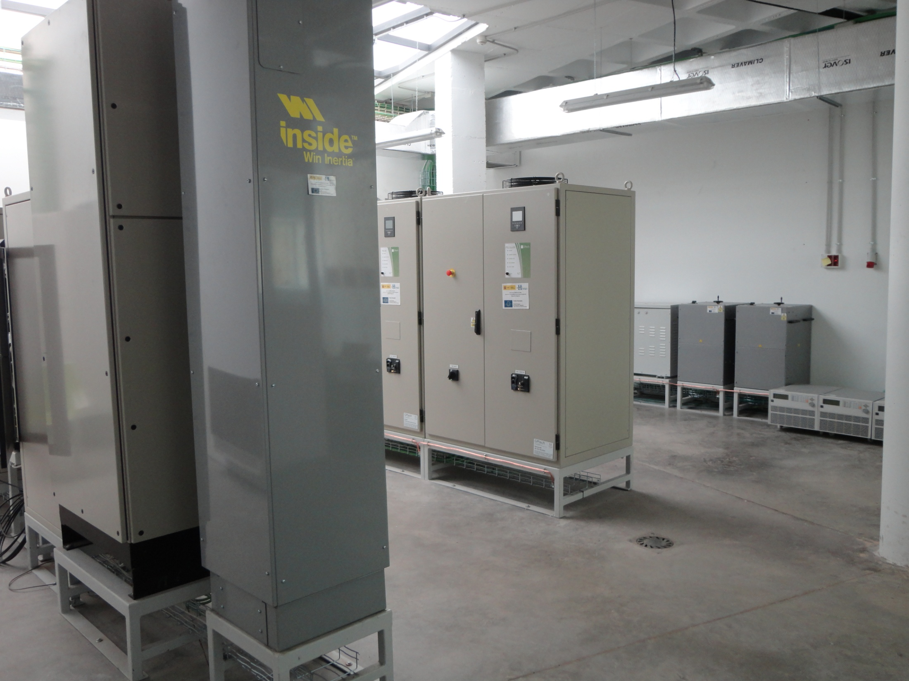
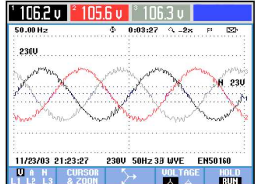
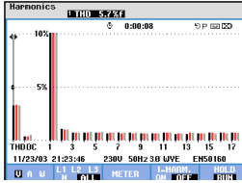

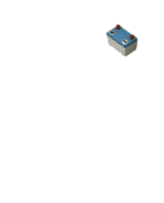




















































$$\min{J_{local}}={\left.\sum_{h_{i}=1}^{HC}{J_{α}\left(P_{α}(h_{i}),δ_{β}(h_{i})\right)}\right|}_{α=grid,uc, bat,fc, elz}^{β=fc, elz}$$
$$U^{ref}$$
$$w^{ref}$$
$$U_{grid}^{meas}w_{grid}^{meas}$$
Power Quality Management of Interconnected Microgrids Using Model Predictive Control
F. Garcia-Torres, S. Vazquez, C. Bordons, I. Moreno-Garcia, A. Gil, P. Roncero-Sanchez
s.t.
$$P_{α}^{min}≤{\left.P_{α}(h_{i})≤P_{α}^{max}\right|}_{α=grid, uc, bat,fc, elz}^{}$$
Islanded Mode
Grid
Connected
$${∆P}_{α}^{min}≤{\left.{∆P}_{α}(h_{i})≤∆P_{α}^{max}\right|}_{α=grid, uc,bat,fc, elz}^{}$$
TERTIARY
CONTROL
$$P_{grid}^{sch}$$
SECONDARY
CONTROL
$$P_{grid}^{ref}$$
PRIMARY
CONTROL
$$0≤{\left.δ_{β}(h_{i})≤1\right|}_{β=fc, elz}^{}$$
MICROGRID
$$Q_{grid}^{sch}$$
$$Q_{grid}^{ref}$$
$${SOC}_{1}^{sch}$$
$$U_{µgrid}^{meas}w_{μgrid}^{meas}$$
$${SOC}_{γ}^{min}≤{\left.{SOC}_{γ}\left(h_{i}\right)≤{SOC}_{γ}^{max}\right|}_{γ=bat,uc}^{}$$
$$P_{2}^{sch}$$
$$P_{2}^{ref}$$
PRIMARY
CONTROL
$$P_{grid},Q_{grid}$$
$$Q_{2}^{sch}$$
$$Q_{2}^{ref}$$
$${LOH}^{min}≤LOH(h_{i})≤{LOH}^{max}$$
$${SOC}_{2}^{sch}$$
PCC
$$\sum_{i=pv,wt,fc}{P_{i}\left(h_{i}\right)}=\sum_{j=grid, uc,bat,elz,load}{P_{j}\left(h_{i}\right)}$$
$$U_{µgrid}^{meas}w_{μgrid}^{meas}$$
$$P_{N}^{sch}$$
$$P_{N}^{ref}$$
$$Q_{N}^{sch}$$
PRIMARY
CONTROL
$${SOC}_{N}^{sch}$$
$$Q_{N}^{ref}$$
Hydrogen
Hydrogen
Price Prediction and Energy Forecast
$P_{i}^{meas}Q_{i}^{meas}$ ${SOC}_{i}^{meas} ,{LOH}_{}^{meas}$
Hydrogen
$$i_{Lf}$$
S1,n
$$C_{+}$$
S1,a
S1,b
S1,c
Hydrogen
$$R_{Lf}$$
$$L_{f}$$
IPS
$$R_{grid}$$
$$L_{grid}$$
$$R_{LN}$$
$$L_{N}$$
$$v_{C+}$$
Hydrogen
$$v_{dc}$$
Hydrogen
S2,n
$$i_{LN}$$
N
S2,b
S2,c
$$i_{µgrid}$$
$$C_{−}$$
S2,a
$$v_{C−}$$
$$i_{Cf}$$
$$R_{Cf}$$
$$Z_{th}$$
$$i_{grid}$$
N
$$C_{f}$$
Hydrogen
$$v_{PCC}$$
N
N
21st IFAC World Congress, Germany, July 11-17, 2020

Slide 2


C nfigura
Index
measurements
stochasticity
Introduction
MPC approaches for power quality management in microgrids
Controller design
Results
Conclusions
input
PROCESS
reference
output
Communication
exchange
reference
PROCESS
output
Hydrogen
input
stochasticity
Hydrogen
measurements
Hydrogen
Hydrogen
Notes:
In the last edition of the fórum we presented an platform based on MPC to solve the control problem of microgrids with hybrid energy storage system. In this presentation, we will show our advances in this year, we have improved our platform integrating the possibility to manage also the control problem of the interconnection of microgrids.

Slide 3
Introduction
Microgrids can be seen as a key technology to improve power quality and reliability (PQR). Their ability to work in grid-connected or islanded mode is specially adequate to supply energy to sensitive loads even in renewable energy-based electricity systems.
The final power quality obtained in microgrids depends on the exchanged power flow between its local devices connected and the power grid.
An appropriate energy storage system (ESS) connected to a voltage source inverter (VSI) can be used to enhance PQR of the microgrid. The final result not only depend on the VSI topology but also on its control system.
In large facilities, the energy system can be based in several interconnected microgrids
measurements
stochasticity
input
PROCESS
reference
output
Communication
exchange
reference
PROCESS
output
Hydrogen
input
stochasticity
Hydrogen
measurements
Hydrogen
Hydrogen
Notes:
In the last edition of the fórum we presented an platform based on MPC to solve the control problem of microgrids with hybrid energy storage system. In this presentation, we will show our advances in this year, we have improved our platform integrating the possibility to manage also the control problem of the interconnection of microgrids.

Slide 4
C nfigura
Index
measurements
stochasticity
Introduction
MPC approaches for microgrids power quality management
Controller design
Results
Conclusions
input
PROCESS
reference
output
Communication
exchange
reference
PROCESS
output
Hydrogen
input
stochasticity
Hydrogen
measurements
Hydrogen
Hydrogen
Notes:
In the last edition of the fórum we presented an platform based on MPC to solve the control problem of microgrids with hybrid energy storage system. In this presentation, we will show our advances in this year, we have improved our platform integrating the possibility to manage also the control problem of the interconnection of microgrids.

Slide 5
Power Quality Perturbations Definitions according EN-50160 Standard
Parameter | Name | Definition
Amplitude | Voltage Fluctuation | ΔU< 10%U_{ref}
 | Voltage Dip | 90%U_{ref} > U > 1%U_{ref} 10 ms < Δt ≤ 1 min.
 | Short Supply interruptions. Long Supply Interruptions. | U < 1%U_{ref} , Δt ≤ 3 min. U < 1%U_{ref} , Δt > 3 min.
 | Temporary Overvoltage
 | Voltage Variations
Waveform | Transient Overvoltage | Δt = ns -ms
 | Harmonic | f_{harm} = n⋅f_{fund} n= integer number.
 | Interharmonics | f_{interarmónicos} = m⋅f_{fund.} m = non integer
 | Information signals transmitted by the power network | 110 Hz ≤ f ≤ 148,5 kHz and short duration pulses
Frequency | Frequency Variations | f ≠50 or 60 Hz
Simetry | Voltage umbalances | |U_{R}| ≠ |U_{S}| ≠ |U_{T}| or ϕ_{R,S} ≠ ϕ_{S,T} ≠ ϕ_{T,R} ≠ 120º
U = Current Voltage, U_{ref} = Reference Voltage ΔU = |U_{ref} – U|, Δt = duración, f = frequency f_{fund.} = Fundamental frequency U_{R} , U_{S} , U_{T} = Voltage per phase R, S y T ϕ_{R,S} , ϕ_{S,T} , ϕ_{T,R} = Phase Angles R-S, S-T y T-R
In microgrids as electrical power systems, a disturbance in power quality is considered when a deviation from the theoretical sine waveform is found.
The deviation can occur in each of the wave parameters, that is: frequency, amplitude, waveform and symmetry between phases. Depending on its amount, and the sensitivity of the receivers, it may have an impact on one or the other devices.
Islanded mode:
  EN 50160. Characteristics of the voltage supplied by public electricity networks. It is a standard whose purpose is to describe the main characteristics of the voltage supplied by a public low and medium voltage distribution network, under normal operating conditions
Grid-connected mode:
  IEC 61000-3-2: Limits for harmonic current emissions (equipment input current < 16A per phase)
  IEC 61000-3-4: Limitation of emission of harmonic currents in low-voltage power supply systems for equipment with rated current greater than 16 A per phase
Source: Megacal Iberica

Slide 6
MPC approaches for power quality
MPC presents several attractive features to be applied in the PQR management of microgrids. The controller can take into account the future behavior of the power inverter despite its complex dynamics.
The cost function can integrate multiple criteria, allowing the optimization of important parameters like active and reactive power control, harmonics reduction or ripple minimization.
MPC can easily handle the transition between islanded and grid-connected modes achieving faster response than the obtained one by classical PI-PWM controllers. This aspect can be crutial in case of energy supply to critical loads.
Its formulation as Finite Control Set MPC does not require high computational cost which is a relevant issue concerning control problem of power inverters.
measurements
stochasticity
input
PROCESS
reference
output
Communication
exchange
reference
PROCESS
output
Hydrogen
input
stochasticity
Hydrogen
measurements
Hydrogen
Hydrogen
Notes:
In the last edition of the fórum we presented an platform based on MPC to solve the control problem of microgrids with hybrid energy storage system. In this presentation, we will show our advances in this year, we have improved our platform integrating the possibility to manage also the control problem of the interconnection of microgrids.

Slide 7
C nfigura
Index
measurements
stochasticity
Introduction
MPC approaches for power quality management in microgrids
Controller design
Results
Conclusions
input
PROCESS
reference
output
Communication
exchange
reference
PROCESS
output
Hydrogen
input
stochasticity
Hydrogen
measurements
Hydrogen
Hydrogen
Notes:
In the last edition of the fórum we presented an platform based on MPC to solve the control problem of microgrids with hybrid energy storage system. In this presentation, we will show our advances in this year, we have improved our platform integrating the possibility to manage also the control problem of the interconnection of microgrids.

Slide 8
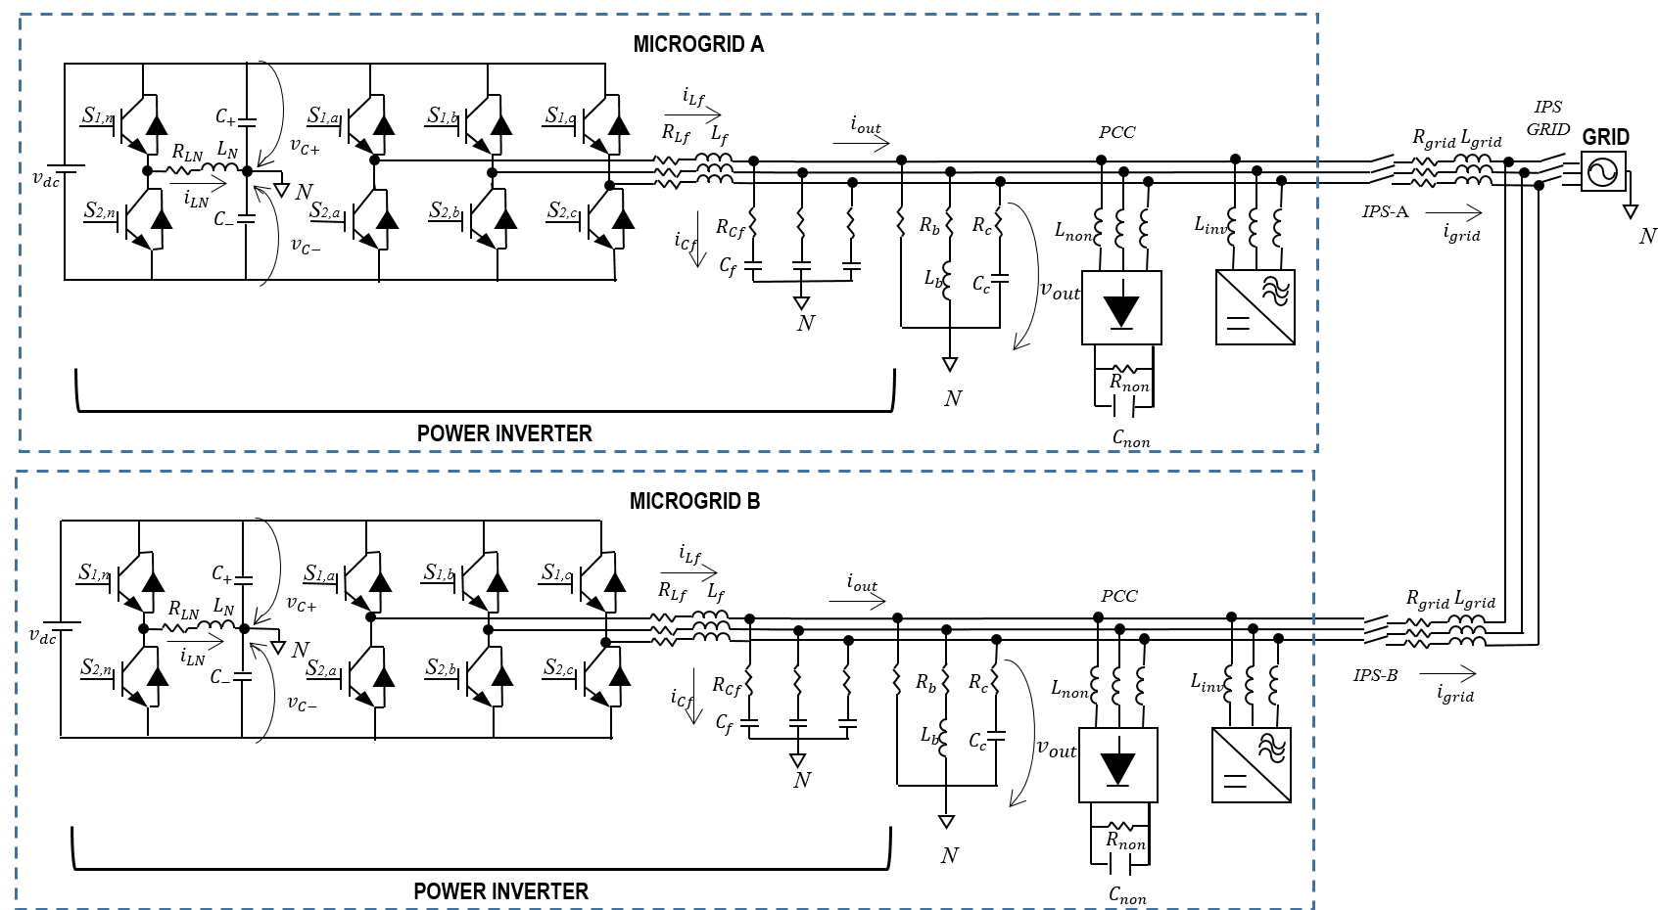
Microgrids Power Architecture
Non-Linear Loads
Unbalanced Loads
Notes:
In the last edition of the fórum we presented an platform based on MPC to solve the control problem of microgrids with hybrid energy storage system. In this presentation, we will show our advances in this year, we have improved our platform integrating the possibility to manage also the control problem of the interconnection of microgrids.

Slide 9










Block Diagram
Working Mode
$$P_{grid}^{ref}$$
$$Q_{grid}^{ref}$$
$$v_{out,γ}\left(k\right)$$
$$S_{1,γ}(t_{k})$$
$$i_{out,γ}\left(k\right)$$
$$𝓤_{out}^{ref}$$
$$i_{grid,γ}\left(k\right)$$
16
16
$$v_{out,γ}\left(k+1\right)$$
Park’s
Transform
PLANT
MODEL
$$i_{out,γ}\left(k+1\right)$$
Zth (k)
Fourier’s
Transform
$$i_{grid,γ}\left(k+1\right)$$
Notes:
In the last edition of the fórum we presented an platform based on MPC to solve the control problem of microgrids with hybrid energy storage system. In this presentation, we will show our advances in this year, we have improved our platform integrating the possibility to manage also the control problem of the interconnection of microgrids.

Slide 10
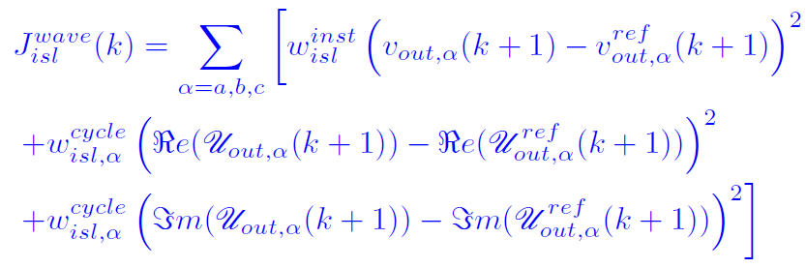
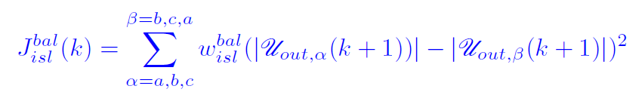
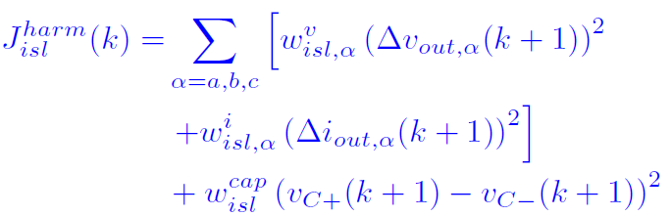
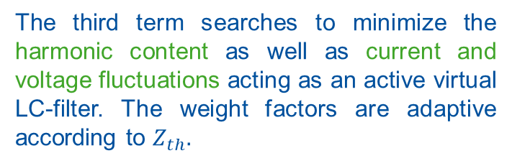
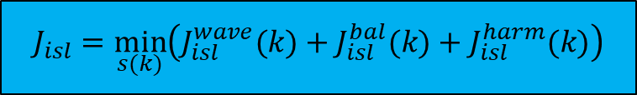
Islanded/Interconnected Mode
$$J_{isl}=\min_{s(k)}\left(J_{isl}^{wave}(k)+J_{isl}^{bal}(k)+J_{isl}^{harm}(k)\right)$$
Standard EN-50160 is followed
The first term of the cost function minimizes
power quality disturbances concerning the
waveform in the short term and the long term calculating the values per cycle in the Fourier’s domain at the fundamental frequency but also the next sample instant.
The second term of the cost function guarantees the simetry between phases
The third term searches to minimize the harmonic content as well as current and voltage fluctuations acting as an active virtual LC-filter. The weight factors are adaptive according to $Z_{th}.$
This term is added as synchronism term
Notes:
In the last edition of the fórum we presented an platform based on MPC to solve the control problem of microgrids with hybrid energy storage system. In this presentation, we will show our advances in this year, we have improved our platform integrating the possibility to manage also the control problem of the interconnection of microgrids.

Slide 11
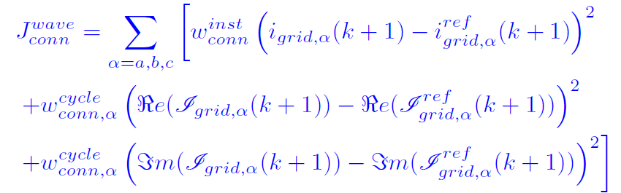
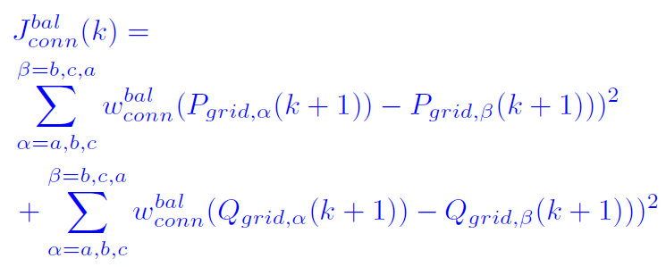
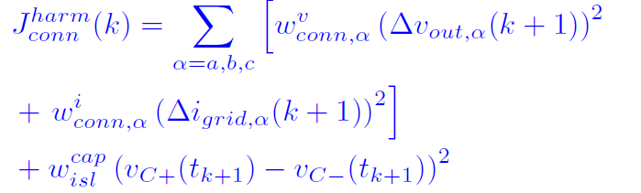

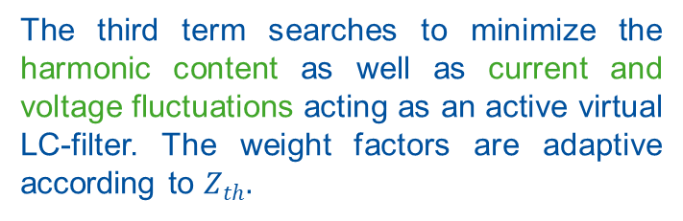
Grid-Connected Mode
Standard IEC 61000-3-2,4 are followed for class A (Balanced Three Phase Equipment) is achieved despite the presence of non-linear and umbalanced loads
$$J_{conn}=\min_{s(k)}\left(J_{conn}^{wave}(k)+J_{conn}^{bal}(k)+J_{conn}^{harm}(k)\right)$$
The first term of the cost function minimizes
power quality disturbances concerning the
waveform in the short term and the long term calculating the values per cycle in the Fourier’s domain at the fundamental frequency but also the next sample instant.
The second term of the cost function guarantees the simetry between phases
The third term searches to minimize the harmonic content as well as current and voltage fluctuations acting as an active virtual LC-filter. The weight factors are adaptive according to $Z_{th}.$
Notes:
In the last edition of the fórum we presented an platform based on MPC to solve the control problem of microgrids with hybrid energy storage system. In this presentation, we will show our advances in this year, we have improved our platform integrating the possibility to manage also the control problem of the interconnection of microgrids.

Slide 12
C nfigura
Index
measurements
stochasticity
Introduction
MPC approaches for power quality management in microgrids
Controller design
Results
Conclusions
input
PROCESS
reference
output
Communication
exchange
reference
PROCESS
output
Hydrogen
input
stochasticity
Hydrogen
measurements
Hydrogen
Hydrogen
Notes:
In the last edition of the fórum we presented an platform based on MPC to solve the control problem of microgrids with hybrid energy storage system. In this presentation, we will show our advances in this year, we have improved our platform integrating the possibility to manage also the control problem of the interconnection of microgrids.

Slide 13
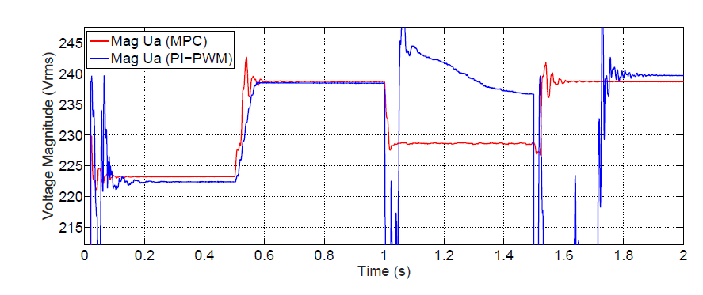

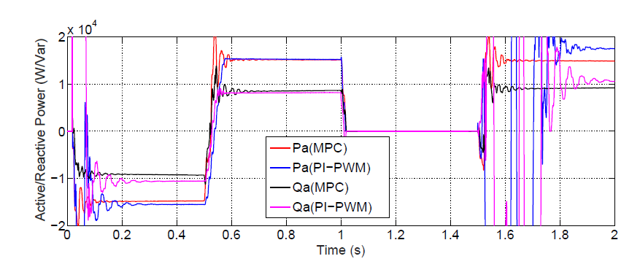
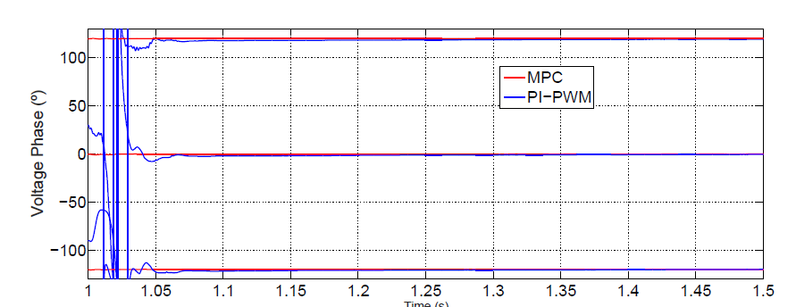

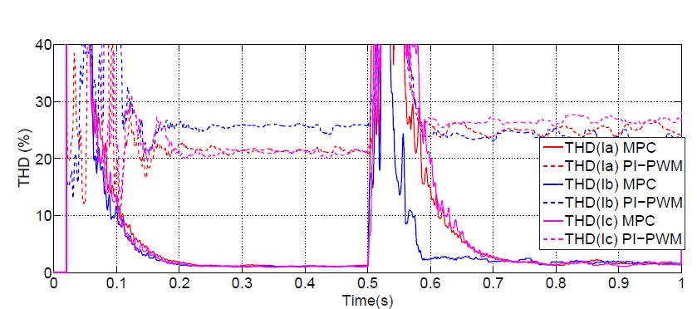
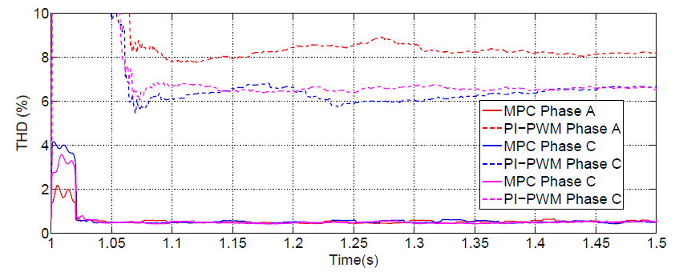
Grid-Connected and Islanded Transition
Power outage
in the main Grid
Notes:
In the last edition of the fórum we presented an platform based on MPC to solve the control problem of microgrids with hybrid energy storage system. In this presentation, we will show our advances in this year, we have improved our platform integrating the possibility to manage also the control problem of the interconnection of microgrids.

Slide 14
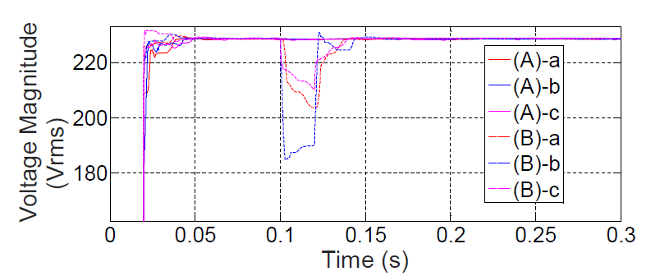
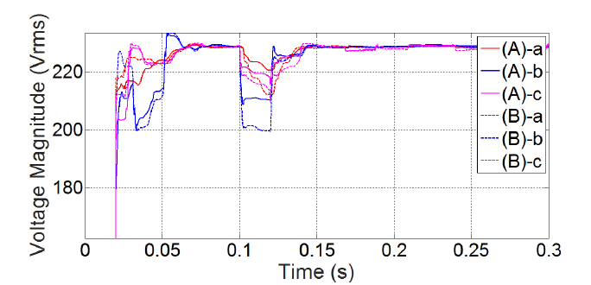
Interconnected Mode
In the case of the microgrid (A) the non-linear loads are connected during all the sample instants of the simulation and the unbalanced loads are connected for these sample instants t>0.1 s.
In the microgrid (B) the unbalanced loads are connected during all the sample instants and the non-linear loads are connected at t>0.1 s.
Case interconnected
Notes:
In the last edition of the fórum we presented an platform based on MPC to solve the control problem of microgrids with hybrid energy storage system. In this presentation, we will show our advances in this year, we have improved our platform integrating the possibility to manage also the control problem of the interconnection of microgrids.

Slide 15


Conclusions
A MPC-based methodology to manage the power quality in interconnected microgrids has been validated and compared under simulation with PI-PWM classical controllers. The control algorithm is applied to a four-wire three-phase VSI with active control of the neutral point which works as master of a microgrid with unbalanced and non-linear loads and generators connected. The simulation results show the potential of the presented MPC-controller in comparison wiht classical PI-PWM controllers solving the transient response problems of traditional methods
The presented work has been developped under the framework of the project CONFIGURA DPI2016-78338-R (Funded by Spanish Ministry of Economy, Industry and Competitiveness) and the European Regional Funds (ERDF) under the Program Interreg SUDOE SOE3/P3/E0901 project IMPROVEMENT
Notes:
This is going to be the index of the presentation. I’m going to make a short introduction of the importance of hybrid ESS, focusing in the advantages and disadvantages of each ESS. I will do a description of the inverter where the control algorithm has been applied. Later on I will explain the details of the controller based on the technique of Model Predictive Control. Next I will show the simulation results. And fnally I will expose the main conclusions of this work

Slide 16

$$\min{J_{local}}={\left.\sum_{h_{i}=1}^{HC}{J_{α}\left(P_{α}(h_{i}),δ_{β}(h_{i})\right)}\right|}_{α=grid,uc, bat,fc, elz}^{β=fc, elz}$$
$$U^{ref}$$
$$w^{ref}$$
$$U_{grid}^{meas}w_{grid}^{meas}$$
Power Quality Management of Interconnected Microgrids Using Model Predictive Control
F. Garcia-Torres, S. Vazquez, C. Bordons, I. Moreno-Garcia, A. Gil, P. Roncero-Sanchez
s.t.
$$P_{α}^{min}≤{\left.P_{α}(h_{i})≤P_{α}^{max}\right|}_{α=grid, uc, bat,fc, elz}^{}$$
Islanded Mode
Grid
Connected
$${∆P}_{α}^{min}≤{\left.{∆P}_{α}(h_{i})≤∆P_{α}^{max}\right|}_{α=grid, uc,bat,fc, elz}^{}$$
TERTIARY
CONTROL
$$P_{grid}^{sch}$$
SECONDARY
CONTROL
$$P_{grid}^{ref}$$
PRIMARY
CONTROL
$$0≤{\left.δ_{β}(h_{i})≤1\right|}_{β=fc, elz}^{}$$
MICROGRID
$$Q_{grid}^{sch}$$
$$Q_{grid}^{ref}$$
$${SOC}_{1}^{sch}$$
$$U_{µgrid}^{meas}w_{μgrid}^{meas}$$
$${SOC}_{γ}^{min}≤{\left.{SOC}_{γ}\left(h_{i}\right)≤{SOC}_{γ}^{max}\right|}_{γ=bat,uc}^{}$$
$$P_{2}^{sch}$$
$$P_{2}^{ref}$$
PRIMARY
CONTROL
$$P_{grid},Q_{grid}$$
$$Q_{2}^{sch}$$
$$Q_{2}^{ref}$$
Model predictive control of reconfigurable microgrids with hybrid and mobile storage
$${LOH}^{min}≤LOH(h_{i})≤{LOH}^{max}$$
$${SOC}_{2}^{sch}$$
PCC
$$\sum_{i=pv,wt,fc}{P_{i}\left(h_{i}\right)}=\sum_{j=grid, uc,bat,elz,load}{P_{j}\left(h_{i}\right)}$$
$$U_{µgrid}^{meas}w_{μgrid}^{meas}$$
$$P_{N}^{sch}$$
$$P_{N}^{ref}$$
$$Q_{N}^{sch}$$
PRIMARY
CONTROL
$${SOC}_{N}^{sch}$$
$$Q_{N}^{ref}$$
Hydrogen
Hydrogen
Price Prediction and Energy Forecast
$P_{i}^{meas}Q_{i}^{meas}$ ${SOC}_{i}^{meas} ,{LOH}_{}^{meas}$
Hydrogen
$$i_{Lf}$$
S1,n
$$C_{+}$$
S1,a
S1,b
S1,c
Integration of combined cooling, heating and power microgrids in zero-energy public buildings under high power quality and continuity of service requirements
Hydrogen
$$R_{Lf}$$
$$L_{f}$$
IPS
$$R_{grid}$$
$$L_{grid}$$
$$R_{LN}$$
$$L_{N}$$
$$v_{C+}$$
Hydrogen
$$v_{dc}$$
Hydrogen
S2,n
$$i_{LN}$$
N
S2,b
S2,c
$$i_{µgrid}$$
$$C_{−}$$
S2,a
$$v_{C−}$$
$$i_{Cf}$$
$$R_{Cf}$$
$$Z_{th}$$
$$i_{grid}$$
N
$$C_{f}$$
Hydrogen
$$v_{PCC}$$
Contact:felix.garcia@cnh2.es
N
N

