Slide 1
IoT-based submetering for DSM-DR application in Energy Smart Appliances
Antonio Moreno-Munoz
Industrial Electronics and Instrumentation R&D, University of Cordoba
Notes:
Good morning everyone, it’s a pleasure to be here in such special times. I am Antonio Moreno-Munoz
Head of the Industrial Electronics and Instrumentation R&D at the University of Cordoba.
First, I would like to thank the Chairman, the organization, and the scientific committee for inviting me to this Conference on Renewable Energy
https://premc.org/conferences/icren-renewable-energy/plenary-speakers/#menu

Slide 2
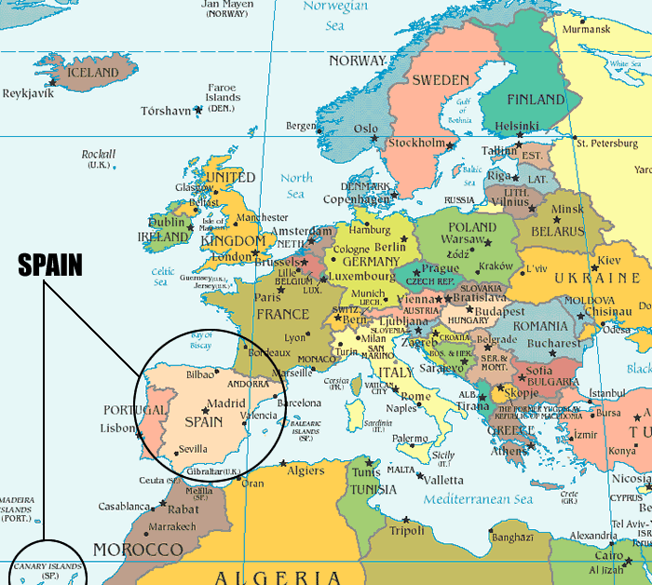
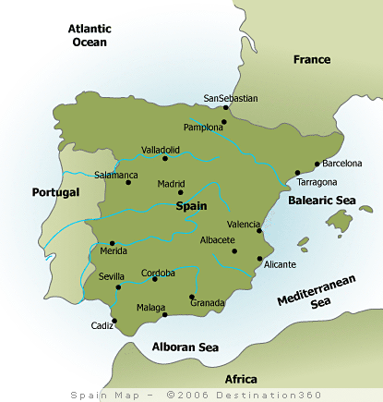
Universidad de Córdoba (UCO) location
Notes:
For those of you who don’t know where is my University, Cordoba, as you can see in the picture, it is an inland city, located in the southwest of Spain.
Let’s see the agenda!

Slide 3
Agenda
Demand Side Management/Demand Response
Grid-Interactive Efficient Buildings (GEB) and Energy Smart Appliance (ESA)
Relevance of Submetering
Power Quality Data Analytics
Conclusions
Notes:
I have divided my presentation into these parts:
First, I will start with a brief background on Demand-side Management and Demand Response.
To follow with an overview of Grid-Interactive Efficient Buildings (GEB) and Energy Smart Appliance (ESA)
Thirdly, I will show the relevance of Submetering
In the last place I would like to illustrate the paradigm of Power Quality Data Analytics and how we have applied it.
To finish with the conclusions

Slide 4
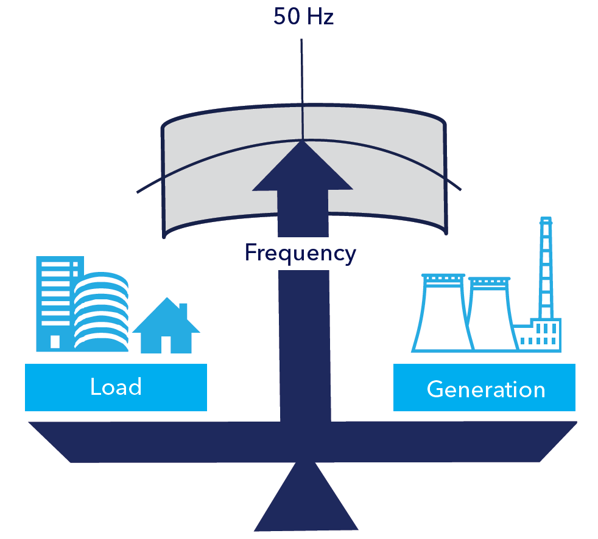
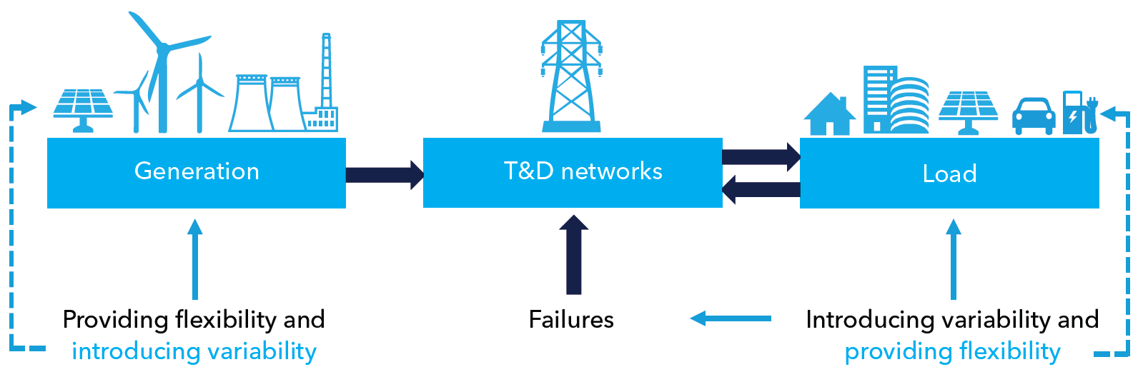
Variability and flexibility in power system
Variability in generation is increasingly present due to the large-scale integration of RES like solar or wind.
Flexibility services can be provided not only on the supply side, but also by improving power transmission and on the demand side…
Notes:
As higher levels of RE are integrated into the grid, the main technical challenges is to deal with variability
This is changing the structure and operation of the current power systems.
Flexibility services can be provided not only on the supply side, but also by improving power transmission and on the demand side…

Slide 5
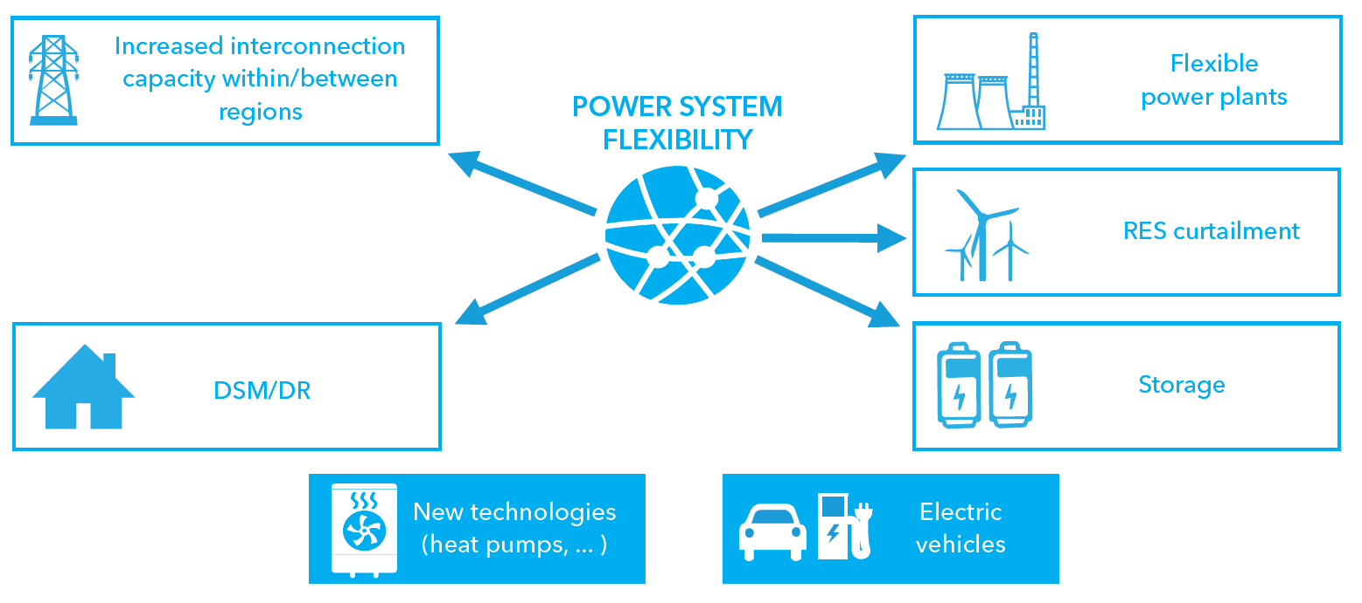
Flexibility options in the power system
The current state of technologies and advances that allow for more active and dynamic consumer behavior can also provide flexibility to the system trough…
    Demand-Side Management/Demand Response
Notes:
We could take advantage of the current state of technology but above all the attitude of the digital consumer regarding traditional appliances and the new ones through…..

Slide 6
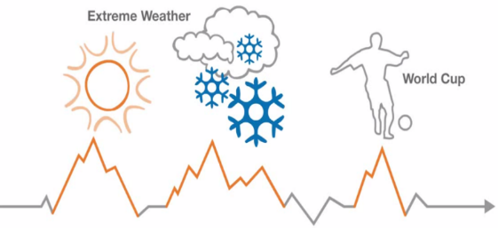
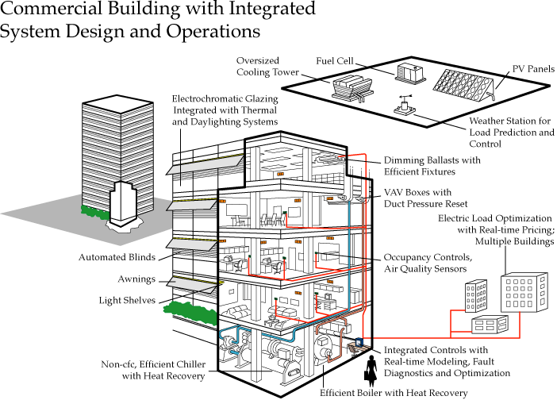
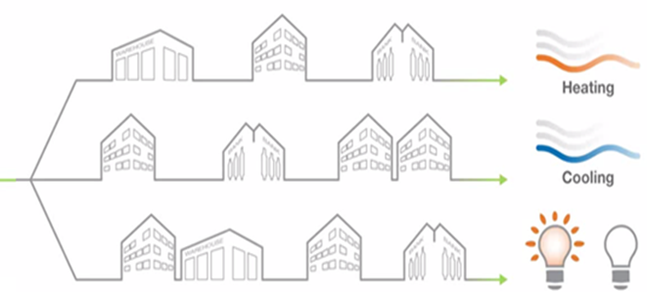
Demand Side Management
Demand-Side Management (DSM) comprises a portfolio of measures to improve the energy system at the side of consumption*.
Air handling
  Air conditioning and circulation, variable speed drive fans
  Short term change to temperature set point doesn’t affect comfort and can reduce a building’s consumption by 20%
Building Management Systems
Existing management systems can be used to intelligently and automatically control systems
  Lighting
  Common area, floor and feature lighting
  Shutting off or dimming certain lights for a short time can cut consumption by 15%
* Palensky, P., & Dietrich, D. (2011). Demand side management: Demand response, intelligent energy systems, and smart loads. IEEE transactions on industrial informatics, 7(3), 381-388.
Notes:
It ranges from improving EE by using better materials, over energy tariffs with incentives for certain consumption patterns, up to sophisticated EMS

Slide 7
Demand Response
Demand response (DR) can be defined⁽¹⁾ as changes in electric usage by end‐use customers from their normal consumption patterns in response to changes in the price of electricity over time, or to incentive payments designed to induce lower electricity use at time of high wholesale market prices or when system reliability is jeopardized
Demand-Side Management
Energy Eficiency
Demand Response
Explicit DR
High Efficiency Equipment
Energy Conservation (behavior)
Implicit DR
⁽¹⁾ U.S Department of Energy (DOE)
Source: Harry Vreuls, Experts meeting Task 21 April 29/30 March 2010
EE-DR Convergence
Notes:
So, DSM programs includes both energy efficiency (EE) and DR programs
DR has already proven to be a resource that the grid operator can use to provide system reliability, stability, and security services.
We have here a good definition of DR…The key here is: how could we engage the user to change his habits?
EE include both…while DR is divided in explicit and implicit measures, that I will explain next
Clearly, we have here a convergence, because energy conservation measures are a behavioral issue as well

Slide 8
Demand Response Programs
DR services are normally classified in two groups attending to mechanism used to promote the response
  Explicit Demand Response
  Implicit Demand Response
  This is committed, dispatchable DR action traded on the energy market. Usually provided by an independent aggregator or a supplier. Consumers receive an incentive to change their consumption when required: grid congestion, balance problems, etc. This is referred to as “incentive driven” DR.
  Consumers choose to be exposed to hourly or shorter-term tariffs in which the price of electricity varies depending on production costs. Adapting their demand (through automation or personal choices) to save on energy expenses. This is referred to as “price-based” DR.
  Definition
  Direct Load Control (DLC)
  Interruptible/curtailable rates (I/C)
  Demand bidding/Buy-back programs (DB)
  Emergency Demand Response Programs (EDRP)
  Capacity Programs (CAP)
  Ancillary Services markets program (A/S)
  Time-of-use (TOU)
  Critical peak pricing (CPP)
  Real-time pricing (RTP)
  Products
Notes:
Explicit DR, through aggregation or virtual power plants (VPP), is divided into traditional-based and market-based.
On the other hand, Implicit DR are voluntary programs in which consumers are exposed to electricity prices that vary over time, e.g.
Time-of-use (TOU) tariff
Real-time pricing (RTP) tariff

Slide 9
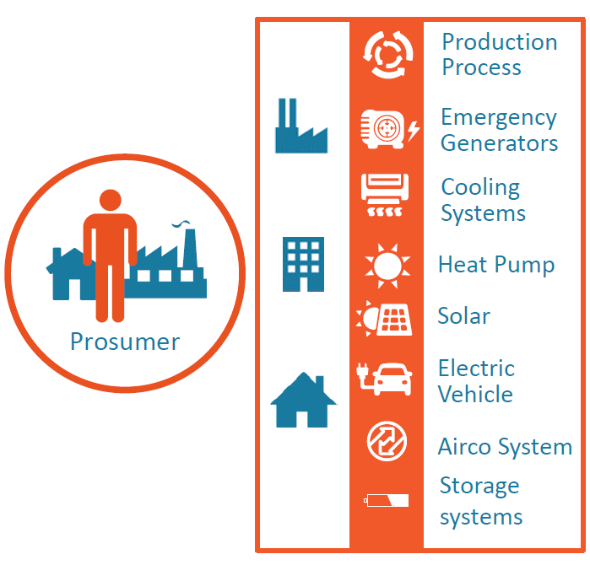
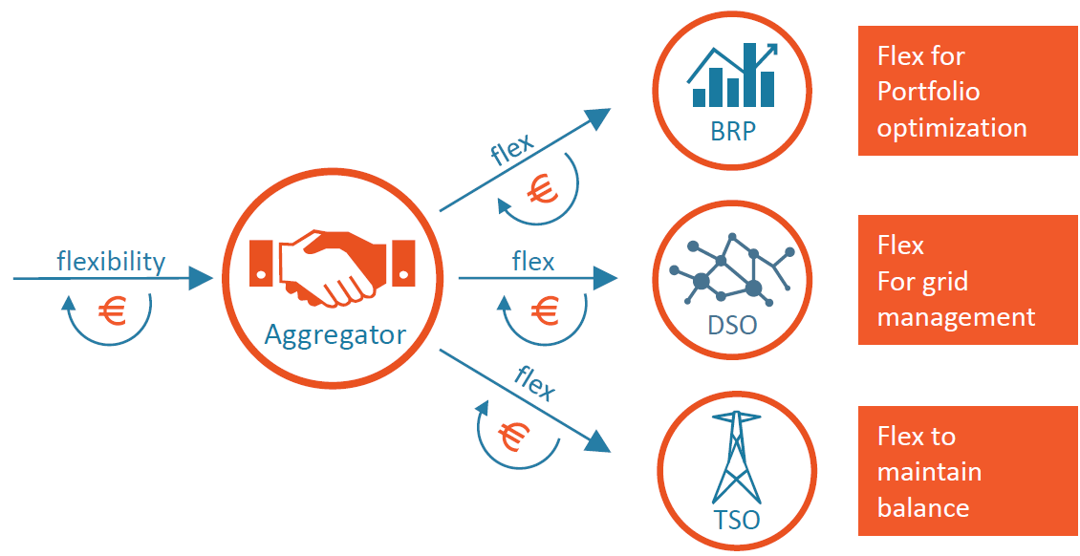
The role of the Aggregator
Explicit Demand Response
An Aggregator explores, contracts, operates, aggregates and valorizes the flexibility of Prosumers
A Balance Responsible Party (BRP) is responsible for actively balancing supply and demand for its portfolio of Producers, Suppliers, Aggregators, and Prosumers.
EU Clean Energy Package: “Consumers and communities will be empowered to actively participate in the electricity market and generate their own electricity, consume it or sell it back to the market while taking into account the costs and benefits for the system as a whole”.“Every consumer will be able to offer demand response and to receive remuneration, directly or through aggregators” https://ec.europa.eu/energy/en/topics/energy-strategy-and-energy-union/clean-energy-all-europeans
Real Decreto-ley 15/2018, de 5 de octubre. El autoconsumo no será principalmente para el uso de viviendas aisladas, sino de amplias comunidades que, además, podrán asociar el autoconsumo a servicios energéticos que permitan una gestión de la demanda compartida, la acumulación compartida, la agregación compartida.
Notes:
Explicit DR requires the possibility to access the different wholesale market segments and a facilitator who offers flexibility where needed.
This role is labeled “aggregator” and can be taken by a supplier or a third independent party.
The role of the aggregator has been propelled as a provider of innovative flexibility tools.

Slide 10
Demand Response results
Demand response measures and other technology options in the framework of Demand-side management
1
2
3
4
An Overall Demand reduction
A movement of demand from peak to off-peak
A high demand on off-peak
A demand reduction on peak hours
Improvements in the energy efficiency of appliances and processes
Increasing user awareness of energy efficiency
Time of use tariff
Demand participation in electricity markets
Pumping
Onsite energy storage
Electric vehicles
Industrial DR: Interruptibility service
Direct Load Control (DLC) programs
The final goal of demand response products is to influence customers to reduce energy consumption in response to conditions within the electricity system
Notes:
Regarding the results, considering the consumption curve of any given day, one can expect….

Slide 11
Demand Response Programs description
Some of the most common incentive-based and price-based DR products are:
Time-of-use (TOU) Rate: A rate with different unit prices for usage during different blocks of time, for a 24-hour day. Daily pricing blocks include an on-peak, partial-peak, and off-peak price for non-holiday weekdays, being the on-peak price the highest, and the off-peak price the lowest.
Real Time Pricing (RTP): A retail rate in which the price fluctuates hourly reflecting changes in the wholesale price of electricity. These are typically known to customers on a day-ahead or hour-ahead basis.
Critical Peak Pricing (CPP): Hybrid of the TOU and RTP. The basic rate structure is TOU. However, the normal peak price is replaced with a much higher CPP event price under specified trigger conditions (e.g., when system reliability is compromised, or supply prices are very hig)
Demand bidding/buyback programs (DB): The utility pays an incentive to reduce electric load when notified of a DR event day. Customer submit load reduction bids for a DBP event, which can be called on a day-ahead or day-of basis. For any event, customer may elect to submit or not submit a bid.
Direct load control (DLC): Allows the aggregator control over certain equipment, e.g. switching-off noncritical loads or modifying devices’ setpoint in order to reduce net electrical load.
Emergency demand response programs (ERDP): customers receive incentive payments for load reductions when needed to ensure reliability
Interruptible/curtailable (I/C): customers receive a discounted rate for agreeing to reduce load on request
Ancillary services market programs: customers receive payments from a grid operator for committing to restrict load when needed to support operation of the electric grid (i.e., auxiliary services)
Capacity market programs (CAP): customers offer load curtailments as system capacity to replace conventional generation or delivery resources. Customers typically receive day-of notice of events and face penalties for failure to curtail when called upon to do so. Incentives usually consist of up-front reservation payments
Source: Coordination of Energy Efficiency and Demand Response, A Resource Of The National Action Plan For Energy Efficiency. U.S. Department of Energy
Source: IEA-DSM Tasks
Notes:
11

Slide 12
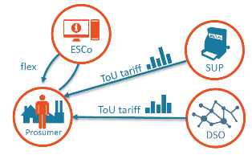
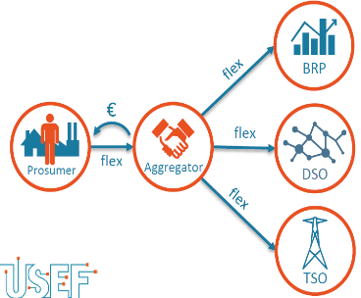
Demand Response programs timescale
  Implicit Demand Response
1-10 years system planning
Day-ahead economic scheduling
Day-of economic dispatch
Day-ahead hourly pricing (RTP)
Time of Use Rates (TUR)
Real time hourly pricing (RTP)/Critical peak pricing (CPP)
Emergency Programs (EDRP)
< 15 min
6-12 months operational planning
Other DSM measures:
Energy Efficiency
Demand bidding/Buy-back programs
Capacity and Ancillary services Programs
Interruptible and curtailable services programs
Direct Load Control
Flexibility
  Explicit Demand Response
Notes:
Figure describes the potential impact of DR measures on customer service levels.
The opportunities and potential depend on the existing building and appliances infrastructure.
The EE category of actions incorporates both:
short-term conservation actions
and long-term investments.

Slide 13


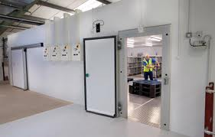
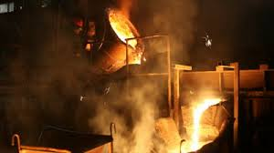



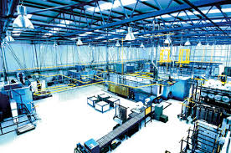
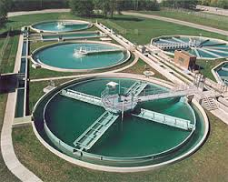
Demand Flexibility potential assets
Mining & Quarries
  Bitumen tank heating
  Crushers
  Grinders
  Conveyer belts
  Variable speed drives
  Building management systems
Commercial property
  Chillers
  AHU’s
  Pumps
  Fans
  UPS
  Building management systems
Commercial refrigeration
  Supermarket refrigeration
  Cold storage
  Compressors
  Refrigerator packs
  UPS
  Variable speed drives
Foundries & Metal processing
  Electric induction furnaces
  Ovens
  Pumps & melting pots
  Variable speed drives
  Building management systems
Airport & Hospitals
  Onsite generation
  UPS
  Combined heat & power system
Universities
  Chillers
  Electric heating
  Standby diesel generation
  AHU’s
  Laundry rooms
IT & Telecoms
  Computer air conditioning units
  Chillers
  DRUPS
  UPS
  Batteries
Manufacturing
  Electric hot water boilers
  Pumps
  Variable speed drives
  Fans
  Building management systems
Water treatment & processing
  Variable speed drive pumps
  Blowers
  Aerators
  Motors & industrial plant
  BMS/PMS
DR products are oriented to change energy pattern, either promoting active participation or allowing an aggregator to manage energy consumption
Notes:
In all the facilities we can find different equipment and systems that can be used in the DR strategies.
Recently the term Grid-Interactive Efficient Buildings (GEB) has been coined.

Slide 14
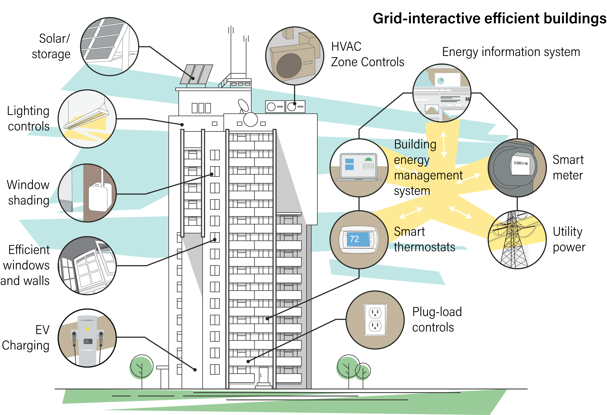
Grid-Interactive Efficient Buildings (GEB)
GEB have a holistically optimized blend of energy efficiency, energy storage, renewable energy, and load flexibility technologies enabled through smart controls.
https://www.aceee.org/grid-interactive-efficient-buildings-gebs
Notes:
This can be seen from two viewpoints: 1) as an individual building, and 2) as part of the electrical grid.
First, they are foremost EE, incorporating both passive and active strategies. Passive design measures include the orientation of the building, continuous insulation, EE windows.
While active strategies usually consist of heating and cooling systems, using occupancy sensors and controls to optimize energy use, smart lighting, Solar PV tech. Or in the commercial sector, an EMS.
But the feature that makes it unique is its ability to interact with the local grid system, operating as a demand flexibility resource. So, as results let see the load profile of

Slide 15
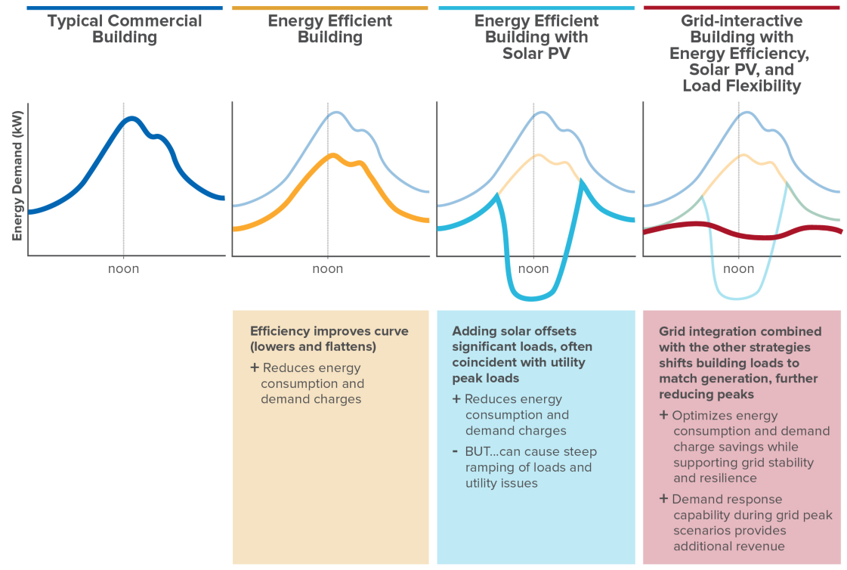
Typical GEB load profile
This results in a lower, “flatter,” more flexible energy load profile, which in turn delivers a more resilient and productive building.
At the campus or community scale, additional strategies such as microgrids and district energy systems may be included.
Matt Jungclaus, Cara Carmichael, and Phil Keuhn, Value Potential for Grid-Interactive Efficient Buildings in the GSA Portfolio: A CostBenefit Analysis, Rocky Mountain Institute, 2019. http://www.rmi.org/GEBs_report
Notes:
This is the typical curve of a commercial building
Building managers are always looking for the last EE technologies that allow to flatten this curve.
The third solution could be considered as an option in the past, but the problems involved make it currently unacceptable.
Thus, a complementary use of energy resources such as energy storage and load shifting may be the best option for this type of building
…So now let me focus on the role of the appliances we can find inside this building…
https://www.aceee.org/grid-interactive-efficient-buildings-gebs

Slide 16
Energy Smart Appliance (ESA)¹
Popularly, Smart Appliances (SA) are recognized for having some electronic processing capability and wireless connectivity.
In the energy field, within the framework of Smart Grids, the term "smart" refers to those capable of modulating their electricity demand in response to signal request from the electrical system.
  Thus, incorporating different Demand Response (DR) strategies.
  This would materialize into load-shifting strategies, which shift their operating period from peak to off-peak hours, or load-modulation strategies, which directly reduce or avoid energy use during peak hours.
The ESAs covered include cold and wet appliances; heating, ventilation and air conditioning units; battery storage; and smart EV chargepoints.
Critical issues for effective DR implementation through ESAs:
Cybersecurity: the prevention of unauthorized access to ESAs by third-parties.
Data privacy: the secure storage of personal data on the device or on any controlling part.
Interoperability: the ability of ESAs to work seamlessly across any DR service operated by any system player.
Power quality: the prevention of grid disturbances caused by the incorrect or simultaneous operation of ESAs.
¹ https://www.bsigroup.com/en-GB/about-bsi/uk-national-standards-body/about-standards/Innovation/energy-smart-appliances-programme/
Notes:
Popularly Smart Appliances (SA) are recognized for having some ……
For example, smart washing machines can independently regulate the detergent to be used depending on the weight of the load and the type of fabric. They can also automatically send alerts when the detergent runs out.
……
But to unlock the full potential of smart appliances, designers and manufacturers must first address problems of…

Slide 17
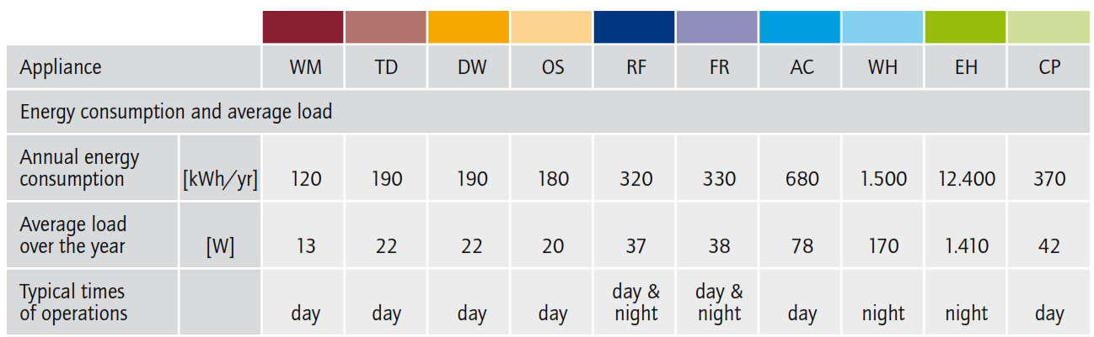
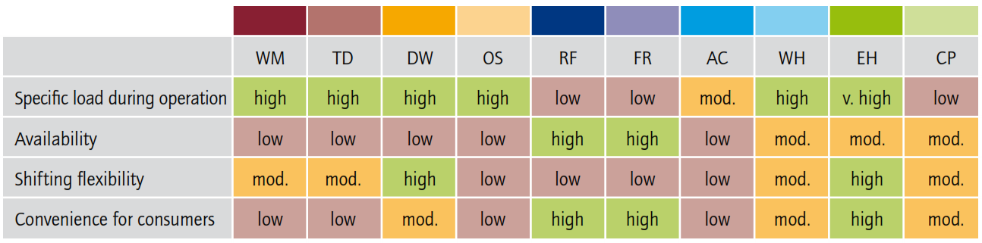


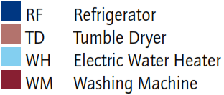
Suitability of appliances in load shifting
Timpe, C. (2009). Smart domestic appliances supporting the system integration of renewable energy. Bericht der Ergebnisse aus dem Projekt, Smart Domestic Appliances in Sustainable Energy Systems (Smart-A).
Notes:
I would like to draw your attention to this report, which, although not recent, is very clarifying about the suitability of the most common appliances,…but going beyond that…

Slide 18
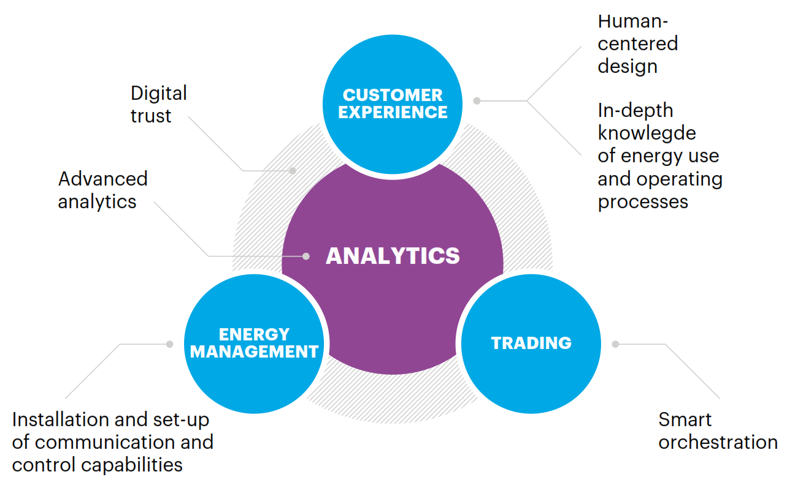
Keys to Successful Demand Flexibility
Successful propositions for demand flexibility require very different capabilities than needed for traditional energy supply business.
Notes:
A Successful strategy for demand flexibility requires …
To adopt a human-centered design to understand the consumer and involved them to join flexibility schemes.
To deeply understand and predict customers' energy use patterns.
Demand flexibility will involve optimization at thousands of points daily. IoT and AI are essential for the management and orchestration of a large and diverse pool of customers.
So, first we are compelled to emphasize the importance of a detailed energy measurement
------------------
Bolster digital trust with strong data privacy and cybersecurity measures to protect business operations and give consumers confidence and peace of mind.
Develop seamless installation and maintenance services, including set-up of communication and control capabilities at consumer premises. Contract with the most reliable manufacturers, logistics operators and installers.

Slide 19
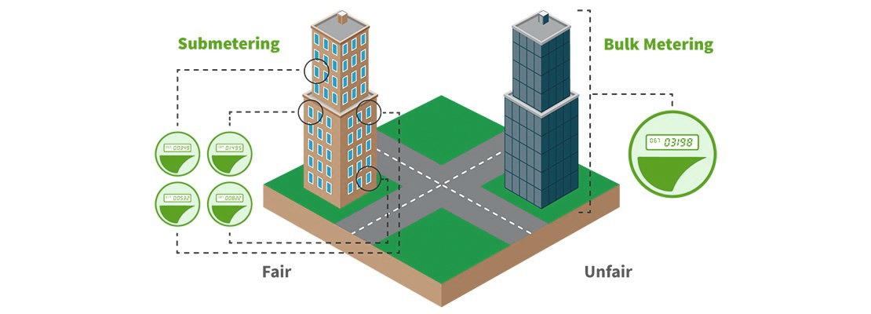
What is Submetering?
Submetering, as opposed to bulk-metering, implies measuring power consumption for individual units or appliances in a building complex¹.
Submeters provide crucial information for more granular measurement of energy consumption data.
¹Alonso-Rosa, M., Gil-de-Castro, A., Medina-Gracia, R., Moreno-Munoz, A., & Cañete-Carmona, E. (2018). Novel Internet of Things Platform for In-Building Power Quality Submetering. applied sciences, 8(8), 1320.
Notes:
….
Unfortunately, submetering is still limited due to the meter costs as well as the technical complexity of installation, operation, and disaggregation.

Slide 20
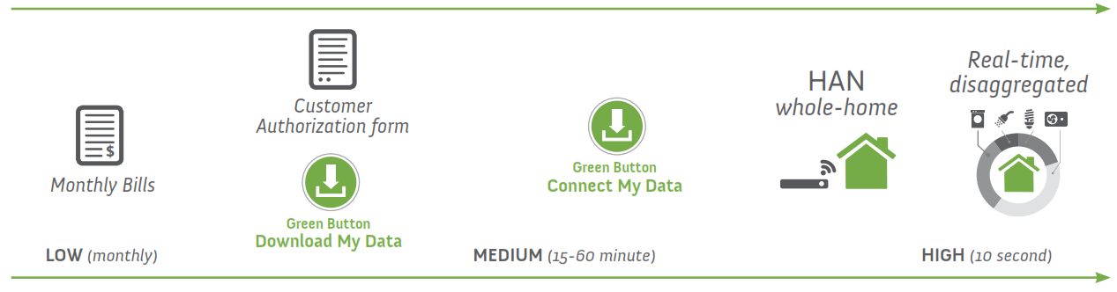
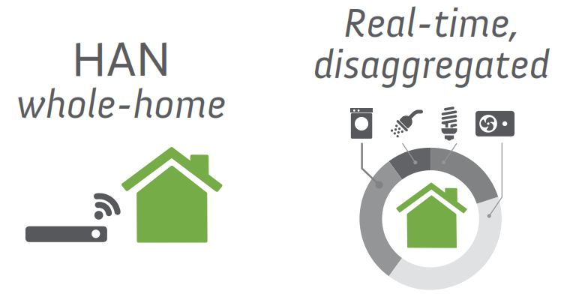
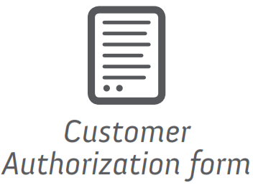

Submetering: the granularity effectiveness
Each additional level of metering was correlated with deeper energy savings, so EMS should integrate system-level and equipment-level submetering¹.
Unlocking hidden benefits such as:
Accurate energy monitoring, detection of utility bill errors.
Ability to record actual electricity use
Comparison of usage across similar appliances over time
Ability to identify equipment running outside schedule, to avoid wasted energy
Fine tuning of energy management
Early access to equipment health and maintenance issues
Ultimately better management of Demand Response requests.
Examples from US have achieved savings of up to 17%, with PB < 1 year².
Low (monthly)
Medium
(15-60‘)
High
(10’’)
TRENDS
¹Zhai, Z. J., & Salazar, A. (2020). Assessing the implications of submetering with energy analytics to building energy savings. Energy and Built Environment, 1(1), 27-35.
²A smarter way to save energy: using digital technology to increase business energy efficiency (2020) https://www.green-alliance.org.uk/a_smarter_way_to_save_energy.php
Notes:
This paper clearly shows that….
…….
Moreover, if the next generation of EMS included data-driven analytics, and machine learning it would unlock hidden benefits such as:
……..
Let's see how IoT can help…

Slide 21
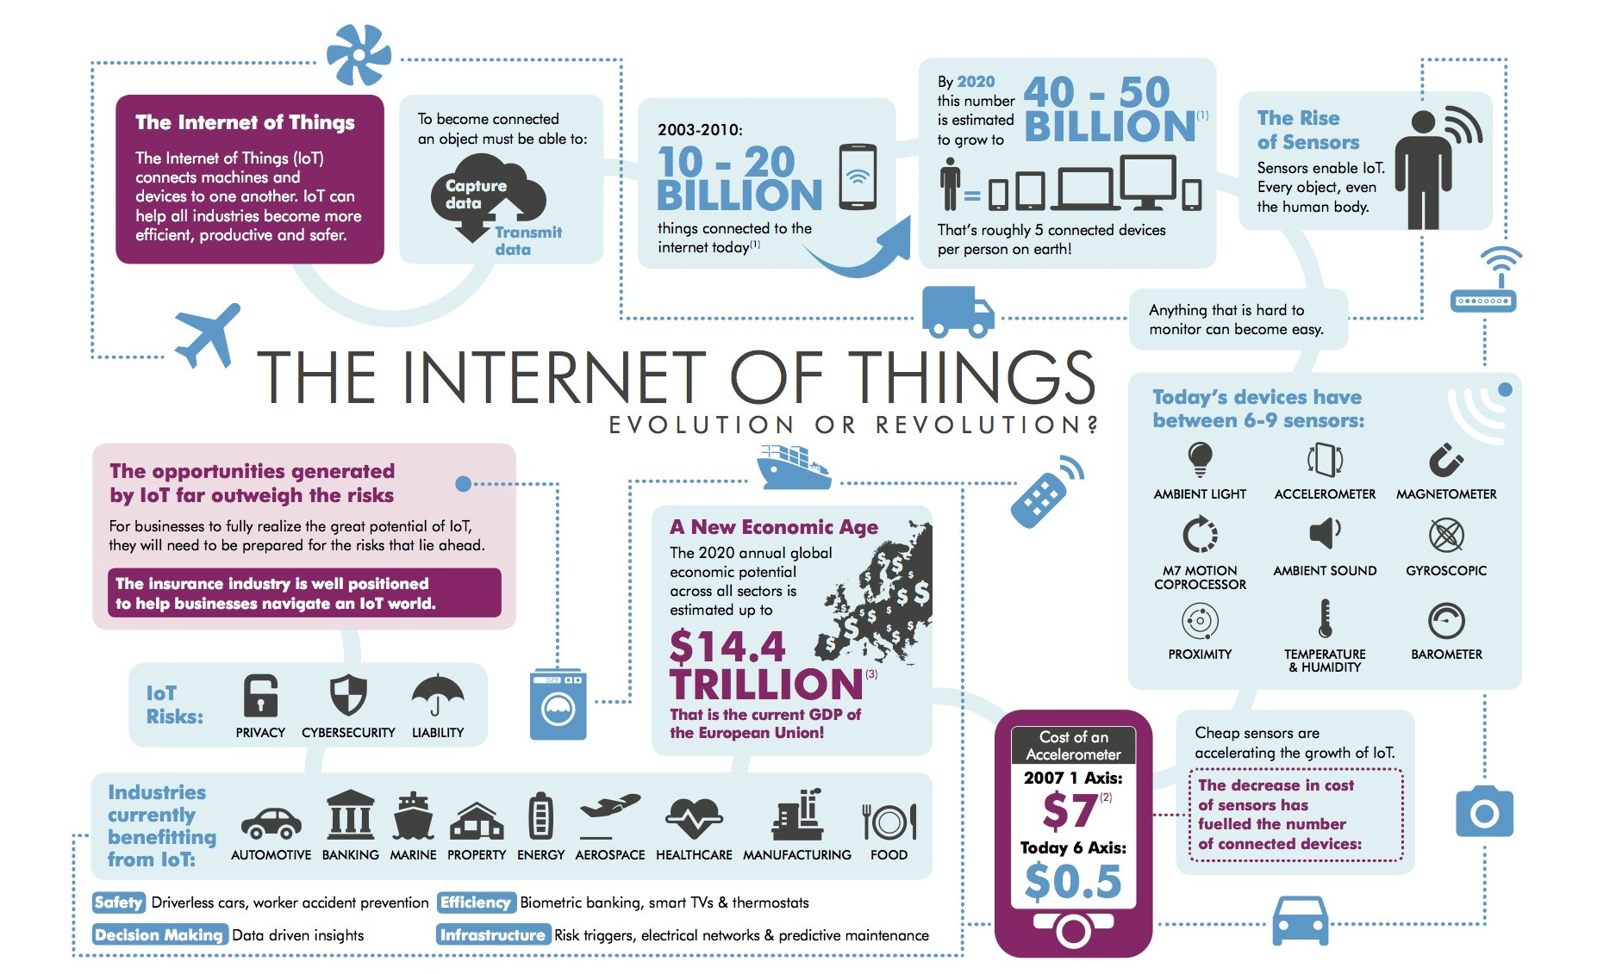

Top IoT Trends in 2020 and beyond!
In
The Internet of things (IoT) describes the network of physical objects—“things”—that are embedded with sensors, software, and other technologies for the purpose of connecting and exchanging data with other devices and systems over the internet
https://en.wikipedia.org/wiki/Internet_of_things
By 2025, the overall economic impact of the IoT could reach $11.1 trillion, surpassing sectors such as "Mobile Internet", "Automation of knowledge work" and "Cloud technology"
$11.1
Notes:
This is a good definition of IoT. The underlying aim is not just to create data, but also to extract valuable insights from the data generated by these devices. The unprecedented boom of IoT has been fueled by several market enablers:
Decrease of sensors and electronic components costs. In the last 15 years the average cost has decreased by more than 40%
Increase of Edge Computing. Centralized computing represents a limitation for IoT, since it increases the amount of data transferred and the related costs. Edge computing allows processing exactly where and when it is required.
Global hyper-connectivity allows to process at Near Real-Time the information collected by the myriad of deployed IoT sensors.

Slide 22
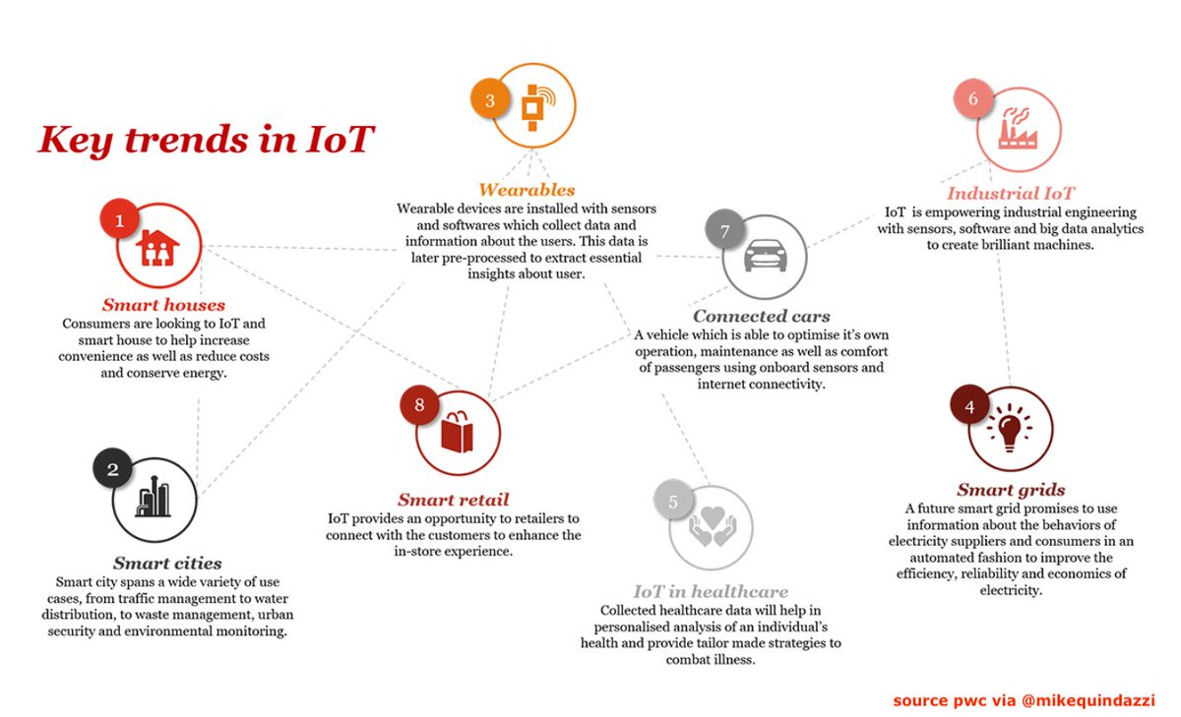
Industries benefiting from IoT adoption
Notes:
The main areas of IoT investments (industries and use cases) include manufacturing operations, transportation, smart grid, smart buildings and, increasingly, consumer Internet of Things, smart home automation and retail.

Slide 23
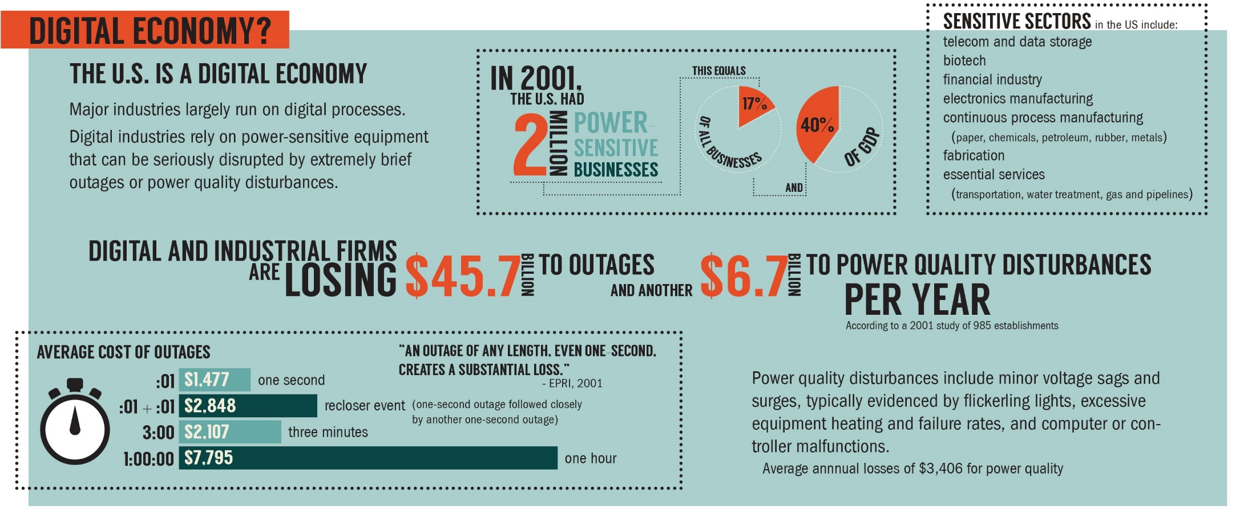
The importance of Power Quality
Digitalization and Industry 4.0
Outages or Power Quality disturbances
EPRI Study
EPRI Study
Notes:
But not only power consumption submetering is relevant. The importance of reliable, high-quality electric power continues to grow as the ongoing digitalization of our societies expand and deepen.
Electronics equipment can be both a source and a victim of poor power quality
The slide shows some of the most vulnerable sectors……industrial and digital firms are collectively losing each year $45.7 billion due to outages, and another $6.7 billion due to PQ disturbances.
Of course, this costs change with the length of the outage, but even the short-ones are costly as it may imply that the systems need to be reset to come back online.
What is more….
-------------------------------------------------------------
Hosting capacity analysis provides an estimate of the amount of DER that can be accommodated without significant upgrades in the grid. Careful consideration of the hosting capacity limits can help significantly in maintaining the secure and healthy operation of the electricity grid and can help avoid damages caused by violating thermal limits or by exceeding the voltage limits set by EN 50160 during times of high production.
The impact of distributed generator (DG) can be quantified using a set of power quality (PQ) indicators that characterize its performance. In some cases, the performance will improve after the DG connection; in other cases, there might be negative impacts on the system. Nevertheless, it is important to realize that those performance indexes should not be exceeded and should be carefully analyzed in the context of their application. Moreover, the performance index is mostly defined as the HC that a system has in accepting renewable energy sources. In other words, the connection of DGs must respect the limits of the proposed PQ indicators.
The hosting capacity approach is presented as a planning, improving, and communication tool for electrical distribution systems operating under specific uncertainties, such as power quality issues, power stabilities, and reliability, among others. In other words, it is an important technique, when renewable sources are present, to answer the amount of power that is possible to supply to the system without trespassing power performance limits. However, the power flow in a distribution system, for instance, can change throughout time due to the penetration of distributed generation, as well as load consumption. Based on the dynamic nature existing in distribution grids nowadays, it is important to highlight that the hosting capacity should not be calculated in a specifically chosen time only but must be analyzed throughout a period of time.
Thus, this paper introduces an extended concept of hosting capacity in relation to an integrated impact of harmonic voltage distortion and voltage rise as a function of time for daily, weekly, monthly, or even yearly periods. This extended concept is named as Dynamic Hosting Capacity (DHC(t)). General aspects of DHC(t) are demonstrated via measured data on a photovoltaic system (PV) connected at a low-voltage (LV) side of a university building.

Slide 24
Dynamic Hosting Capacity
The possible amount of DER penetration that can be safely handled by grids is known as Hosting Capacity (HC).
DR can be employed to manage Hosting Capacity, under PQ constraints.
Castelo de Oliveira, T.E.; Bollen, M.; Ribeiro, P.F.; de Carvalho, P.M.S.; Zambroni, A.C.; Bonatto, B.D. The Concept of Dynamic Hosting Capacity for Distributed Energy Resources: Analytics and Practical Considerations. Energies 2019, 12, 2576.
Palacios-Garcia, E. J., Moreno-Muñoz, A., Santiago, I., Moreno-Garcia, I. M., & Milanés-Montero, M. I. (2017). PV hosting capacity analysis and enhancement using high resolution stochastic modeling. Energies, 10(10), 1488.
Notes:
…distributed energy resources (DER) may lead to PQ problems and operational limit violations in the power system when their penetration exceeds a particular value, called hosting capacity (HC)
DR can be employed to manage Hosting Capacity, under PQ constraints
The detailed and continuous measurement of power quality (PQ) indicators can contribute to a more accurate “Dynamic Hosting Capacity” assessment.

Slide 25

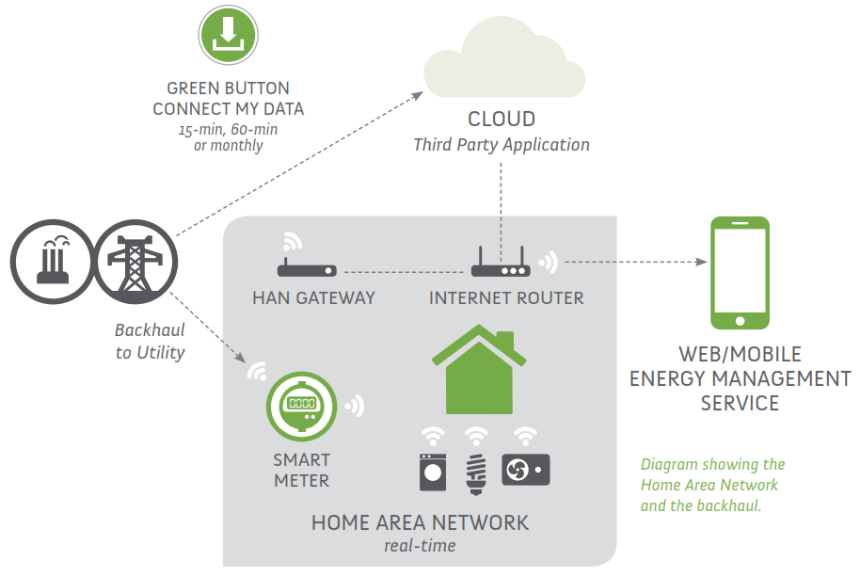


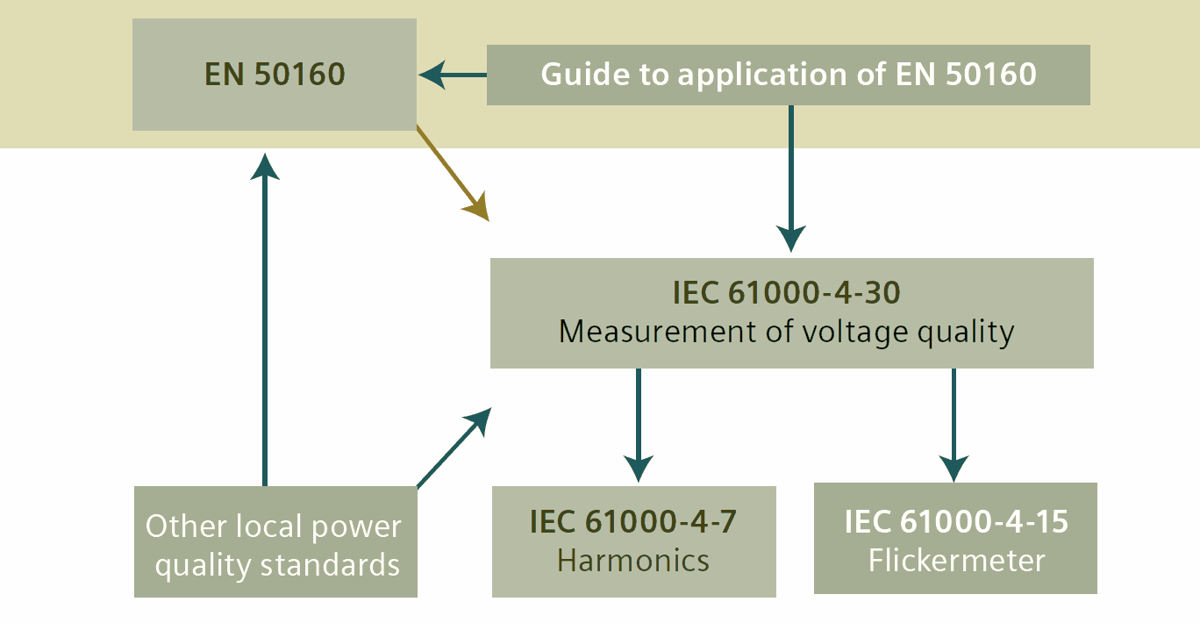



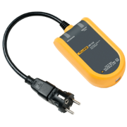
IoT PQ sensor.
IoT PQ sensor
Microgrid-responsive Appliance Controller
J. Garrido-Zafra, A. Gil-de-Castro, R. Savariego-Fernandez, M. Linan-Reyes, A. Moreno-Munoz and F. García-Torres, "A Novel Microgrid Responsive Appliance Controller," 2020 IEEE International Conference on Environment and Electrical Engineering and 2020 IEEE Industrial and Commercial Power Systems Europe (EEEIC / I&CPS Europe), Madrid, Spain, 2020, pp. 1-6, doi: 10.1109/EEEIC/ICPSEurope49358.2020.9160723.
Fluke VR1710 € 857
PQ analyzer < € 17760
Notes:
Within our group, during the last years, different IoT PQ sensors has been developed to be embedded at individual appliances.
The last version is a Grid-interactive Appliance Controller. It works as a Direct Load Controller as well as PQ monitor with a wide range of alarms.
Status information, conﬁguration, PQ data, and even diagnostic data from the appliances can be recorded while in operation and transferred to the cloud for machine learning processing.

Slide 26


About the European Project IMPROVEMENT
IMPROVEMENT, “Integration of combined cooling, heating and power microgrids in zero-energy public buildings under high power quality and continuity of service requirements”
SPAIN: National Hydrogen Center. Leading partner (CNH2).
SPAIN: University of Castilla la Mancha.
FRANCE: National Higher School of Mechanics and Aerotechnics (ENSMA).
PORTUGAL: Higher Technical Institute (IST).
PORTUGAL: National Laboratory of Energy and Geology (LNEG).
SPAIN: General Secretariat of Industry, Energy and Mines of the Junta de Andalucía
SPAIN: University of Córdoba.
SPAIN: Andalusian Energy Agency.
FRANCE: University of Perpignan Via Domitia.
General objective:
Transforming existing public buildings into Nearly Zero-Energy Buildings (NZEB) by integrating Renewable Energy Microgrid with Combined cooling, heat & power (CCHP), and Hybrid Energy Storage System (HESS).
Specific objectives:
Development of Solar Heating & Cooling system, with the incorporation of active and passive techniques for Nearly Zero-Energy Buildings (NZEB).
Development of a fault-tolerant power control system for microgrids under high Power Quality & Reliability design criteria.
Development of an EMS for renewable energy microgrids with Hybrid Energy Storage System (HESS) under criteria of minimum degradation, maximum efficiency and priority in the use of renewable energies.
Notes:
We are using it in IMPROVEMENT. This is an Interreg Sudoe European Project. In the slide you can find the partners involved.
The aim of the project is…
So, we are going to develop….

Slide 27
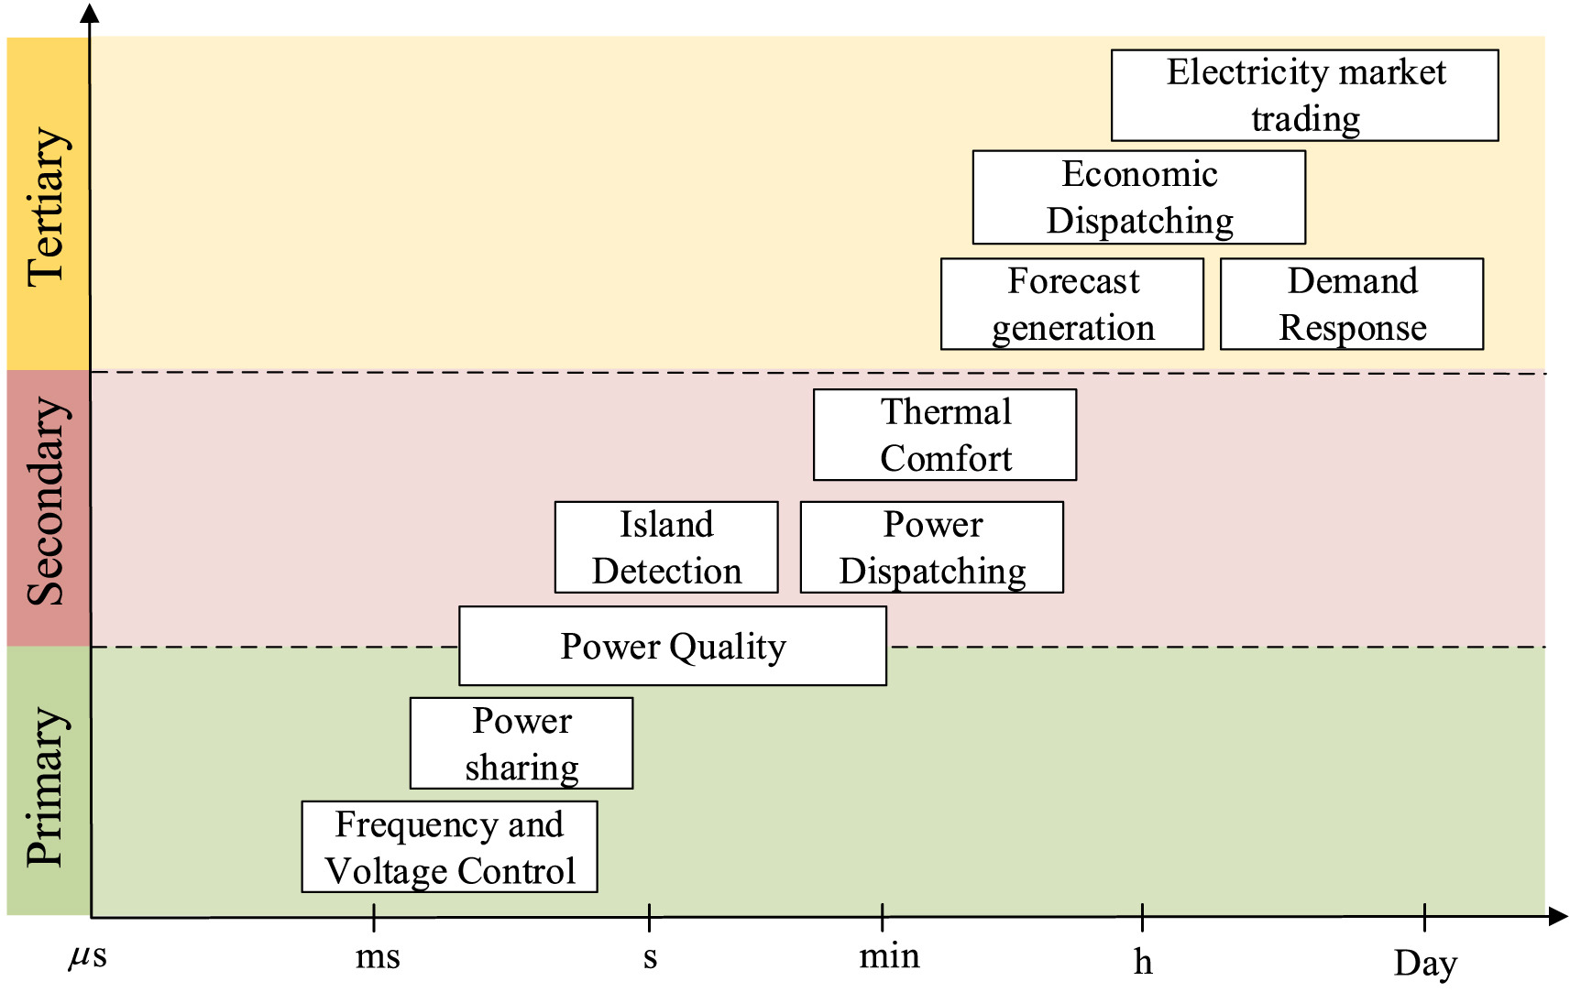
IMPROVEMENT¹ Microgrid control layers
TERTIARY
CONTROL
(Import/Export)
SECONDARY
CONTROL
(Synchronization/
Restauration)
Control layers functions
IoT Power Quality Supervisory System
PRIMARY
CONTROL
(P/Q Droop)
¹ Integration of combined cooling, heating and power microgrids in zero-energy public buildings under high power quality and continuity of service requirements (IMPROVEMENT), co-financed by the Interreg SUDOE Programme and the European Regional Development Fund (ERDF). Ref. SOE3/P3/E0901.
Notes:
Our participation in this Project is devoted to support the MG control system by developing an IoT Power Quality Supervisory System

Slide 28
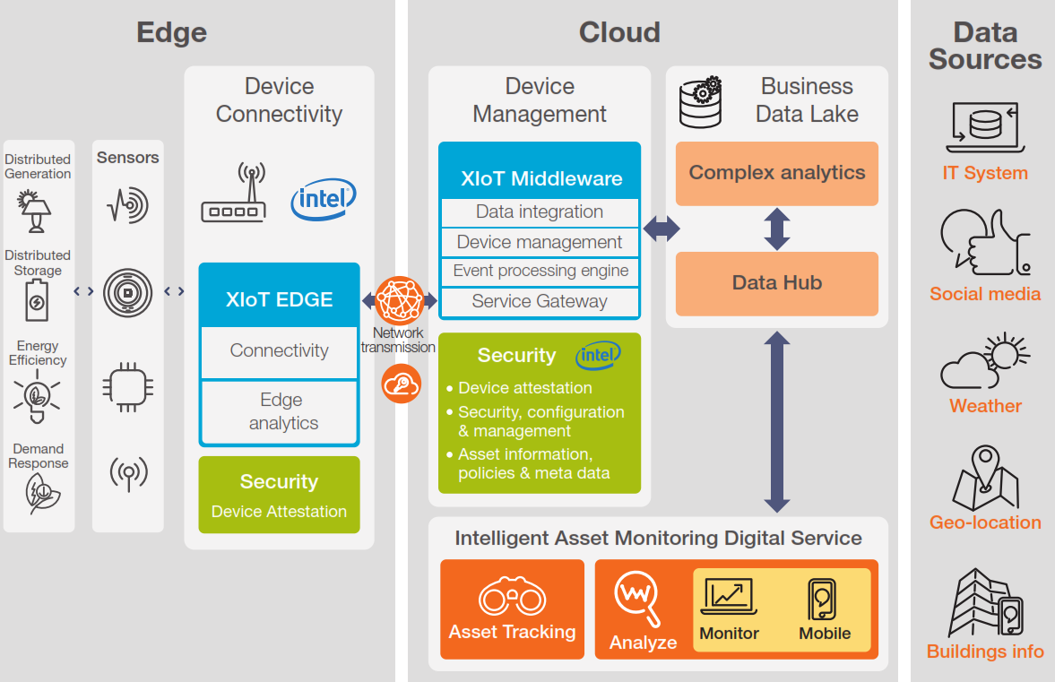




IoT Architecture for Energy Applications
Grid-interactive Efficient Building
Voas, J. (2016). Networks of ‘things’. NIST (National Institute of Standards and Technology), Special Publication, 800(183), 800-183.
Notes:
We have used this IoT reference architecture. Inspired by the model released by the NIST, five core primitives can be established here:
Raw data acquisition from edge devices, assets, and sensors
Aggregation to support big data analytics
Communication (e.g. wireless, wired)
Energy Data Analytics
Decision triggering through Energy Apps.
There are many platform on the market. They must allow you to build a customized, scalable and secure IoT solution. Platforms like Microsoft Azure, Amazon, Google cloud are very popular. Their disadvantage is that they are expensive, private, involving the availability and conditions of the company.
---------------------
The primitives proposed by NIST are: 1) Sensor, 2) Aggregator, 3) Communication channel, 4) eUtility, and 5) Decision trigger:
1. A sensor is an electronic utility that digitally measures physical properties (e.g. temperature, acceleration, weight, sound, etc.) and outputs raw data.
2. An aggregator is a software implementation based on mathematical function(s) that transforms/consolidates groups of raw data into intermediate data.
3. A communication channel is a medium by which the data is transmitted (e.g., physical via USB, wireless, wired, verbal, etc.) between sensor, aggregator, communication channel, decision
trigger, or eUtility.
4. A eUtility (external utility) is a software or hardware product or service, providing computing power that aggregators will likely not have.
5. A decision trigger creates the result(s) needed to satisfy the purpose, specification, and requirements of a specific NoT.

Slide 29

IMPROVEMENT Microgrid project scheme
Notes:
To avoid such company dependency, in IMPROVEMENT the developed IoT infrastructure is based on FIWARE which is widely used in many smart solutions also integrating third-party components.
This is the scheme of the microgrid where our system is going to be deployed.
The IoT PQ sensors are spread through the microgrid
MQTT communication gives greater scalability to the system
An OpenVPN makes the sensors at the CNH2 Pilot be seen from the IoT Platform.

Slide 30

FIWARE Ecosystem Architecture¹
FIWARE: A Standard-based Open Source IoT Platform
¹ Integration of combined cooling, heating and power microgrids in zero-energy public buildings under high power quality and continuity of service requirements (IMPROVEMENT), co-financed by the Interreg SUDOE Programme and the European Regional Development Fund (ERDF). Ref. SOE3/P3/E0901.
Notes:
The figure shows our proposed Fiware architecture.
The Docker technology will be used enabling the deployment of many services such as databases, dashboards,…
CrateDB is a database built specifically for machine data use cases, that means all type of data produced by IoT sensors, infrastructure or platforms.
Additionally, crateDB offers a real-time performance and therefore is able to ingest complex data at very high speed from different sources. This is our case where we’re going to have many sensors sending complex data structures.
Definitively, this is a solid ground for deploying the power quality data analytics approach in IMPROVEMENT

Slide 31
Microgrid Responsive Appliance Controller
Main Characteristics and functionality
Cloud Computing Funtions
Context data management
Entities and attributes definition
Machine learning algorithms
Anticipated anomalies detection thanks to early-stage alerts
Reports and event management
Notify the EMS when a PQ threshold is exceeded
Data storage
Interfaces with things through IoT agents
Create Data Log Trends, Histograms, Profiles, Scatter Charts, and Statistical Summary Tables
PQ Trend forecasting
Alarms generation based on the foreseen behavior (e.g. IEEE 1547)
Site PQ status reports when required by the EMS
Execution of dedicated routines when a DR request is received
Detect, Identify, and Locate Faults.
Correlate PQ event/Fault Events/ EMS operation logs
Energy Smart Appliance
Adquisition & Preprocessing
Acquisition setup: Sampling frequency, acquisition mode, number of channels, etc
Waveform samples retrieval through the SPI bus
Data scaling according to hardware (conditioning circuit, PGA, etc)
Processing (IEC Std. 61000-4-30)
Postprocessing & Communications
Continuous voltage sags and swells monitoring
Harmonic analysis by performing the FFT on current and voltage waveforms
RMS voltage and current, energy and power, power factors, THDs, etc
Data formatting according to Fiware native protocol (NGSI)
MQTT communication management (as a client publisher)
Communication management with other IoT PQ devices to ensure synchronization of measurements
Edge Computing functional block diagram in the IoT Device
Notes:
No mandatory standards for DR in appliances
Reference case from Energy Star

Slide 32
Power quality data analytics
Site PQ Reporting
Predictive Models
Prescriptive Models
PQ Event Log
Monitoring and Data Log
Event Classifications
Diagnostic Models
Statistical evaluation of the Compliance Limit (e.g. Std.EN-50160)
Alarms (e.g. IEEE 1547)
Apply temporal and spatial aggregation windows
10/12 cycles
150/180 cycles
10 min
2 h.
Site PQ&R global index
Anticipated faults detection thanks to early-stage alerts.
Identify and proactively manage reliability issues, establishing clearly whose responsibility it is, e.g. in insurance claims
Correlate PQ and Fault Events
Visual Data Analytics
PQ event log correlation with EMS operation logs
Continuously diagnose of low-voltage ride-through capability
Identify, Analyze, and Locate Faults
Create Data Log Trends, Histograms, Profiles, Scatter Charts, and Statistical Summary Tables
Generate ITIC, SEMI-F47, and Custom Voltage Sag Magnitude-Duration Charts
PQ Steady-state Disturbances Log
Evaluate future predicted alternatives
Recommend optimal scheduling focused on preventative maintenance
Trend forecasting
Power quality data analytics¹ is a discipline that specializes in collecting waveform-based power system data, extracting information from it, and applying the findings to solve a wide variety of power system problems beyond traditional power quality concerns, such as condition monitoring and fault diagnosis.
Edge Computing in IoT PQ sensor
Cloud Computing
IEC Std. 61000-4-30
Time
Prescriptive Analytics recommend several different possible actions and guide them towards a solution.
Predictive Analytics forecast what is most likely to happen in the future
Diagnostic Analytics helps you understand why something happened in the past.
Descriptive Analytics tells you what happened in the past
¹ IEEE Working Group on Power Quality Data Analytics http://grouper.ieee.org/groups/td/pq/data/
Notes:
Although there is not a standard definition about PQ data analytics, the slide shows the definition given by the IEEE. So, in IMPROVEMENT we are going to deploy PQ data analytics by these steps:
PQ monitor (both steady-state and PQ events)
Site reporting by event classification, data aggregation, and even a preliminary evaluation of the compliant limit.
The following will be performed within the Cloud. In e.g., using statistical tools as well as advanced graphs tools.
Diagnostic can be done through different mechanisms, for example, stablishing a new global PQ metric.
Aditionally, we will stablish an advanced alarm supervisory system, and other predictive tools.
Eventually, we’ll also consider some prescriptive actions.

Slide 33
Conclusions
Submetering to capturing more granular in-deep energy data can be critical to properly accommodate Demand Flexibility resources
Detailed Power Quality (PQ) data is also very important as the ongoing digitalization expand. And even more so when using Dynamic Hosting Capacity.
An IoT PQ sensor to be embedded in Energy Smart Appliances (ESA) can be critical.
This will be the cornerstone for the deployment of the PQ data analytics over an IoT platform, in the environment of a Grid-Interactive Efficient Building.
This innovation can be the gateway to the incorporation of new self-diagnostic functionalities in ESA.
Notes:
In the next months, we could see the first experimental results of the Project
So, what are the first conclusions we can extract from this work?

Slide 34

Thanks for your attention!
Contact:
UCO · UNIVERSITY OF Cordoba
Address
Leonardo da Vinci Building
Córdoba (Spain)
Phone & Fax
Phone: +34 957 21 83 73
Email
amoreno@uco.es
Website
http://www.uco.es/icei/en/

Slide 35
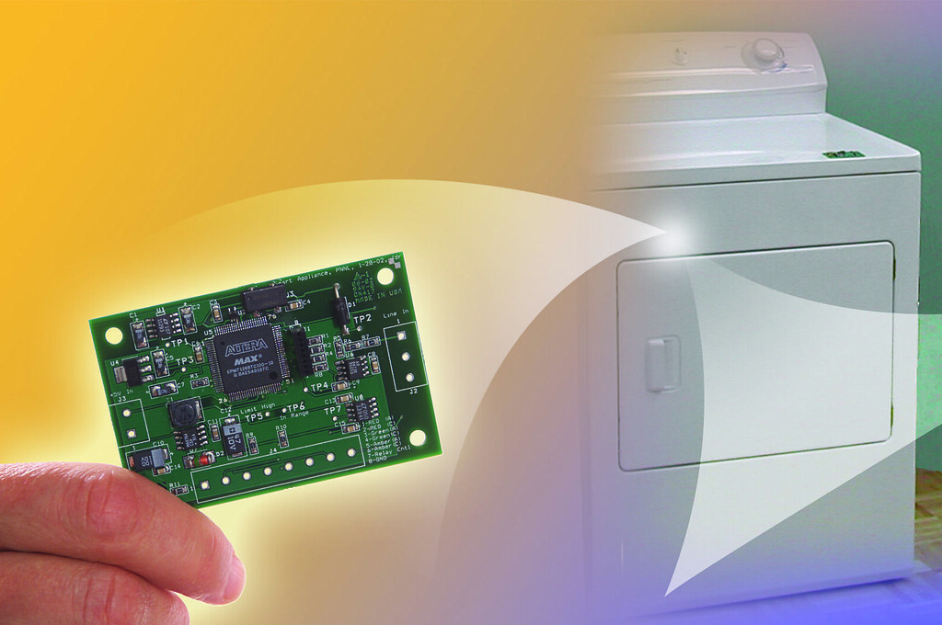
Microgrid Responsive Appliance Controller

Slide 36
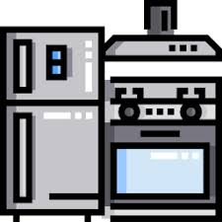


Microgrid Responsive Appliance Controller
Main Characteristics
Parts about communication architecture and techniques are not written in an intuitive language for market mechanisms for customer interoperability and eliminate stranded assets
Requires self certification by vendors, which is a big problem for grid interoperability
Microgrid Responsive Appliance w/External Communications
Power Management Device/application
Microgrid Responsive Appliance might exchange data with one or more:
Smart meter/submeter
DLC-DR/Hub/Gateway
Internet/Cloud Application
Other Device or Application
Microgrid Responsive Appliance
System Boundary
Internal Protocols (open or proprietary)
Protocol Translation
Open Standard Protocol
IoT device(s), link(s) and/or processing that enables open standards-based communication between the Microgrid Responsive Appliance and Energy Management Device/Application(s). These elements could be within the base appliance, and/or an external communication module, a hub/gateway, or in the internet/cloud
Microgrid Responsive Appliance w/External Communications
Notes:
No mandatory standards for DR in appliances
Reference case from Energy Star

